Slide 1
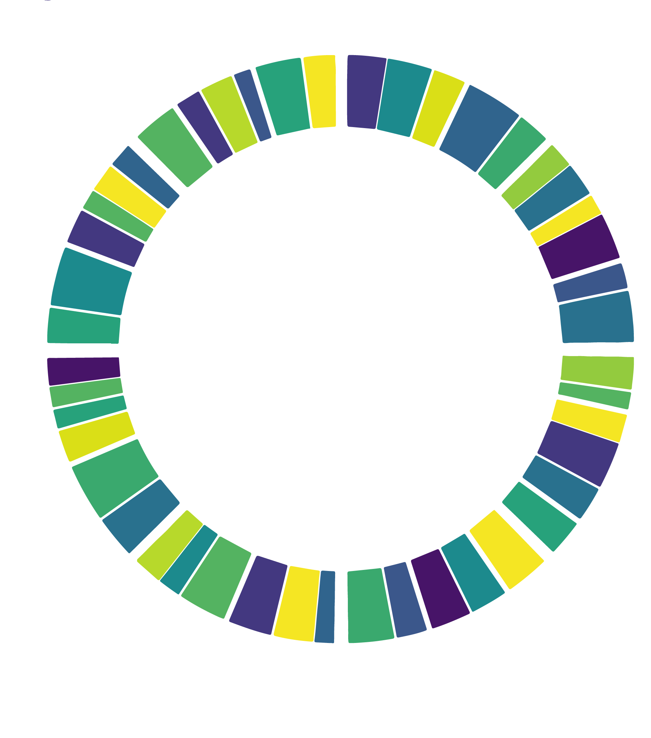
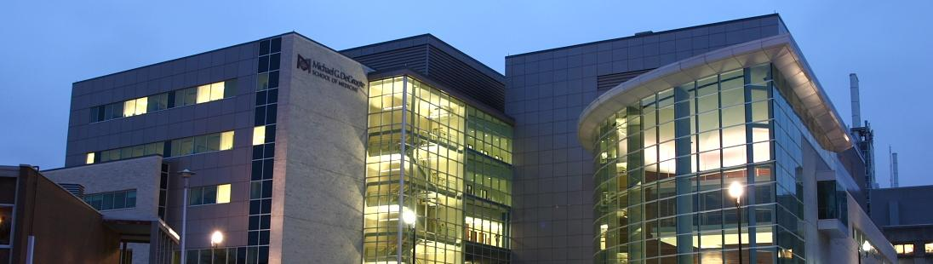
Biocuration, Bioinformatic, and Analytic Approaches to Surveillance of Antimicrobial Resistance Genes
Andrew G. McArthur, Ph.D.
Michael G. DeGroote Institute for Infectious Disease Research
Department of Biochemistry & Biomedical Sciences
McMaster University
mcarthurbioinformatics.ca I card.mcmaster.ca I iidr.mcmaster.ca

Slide 2
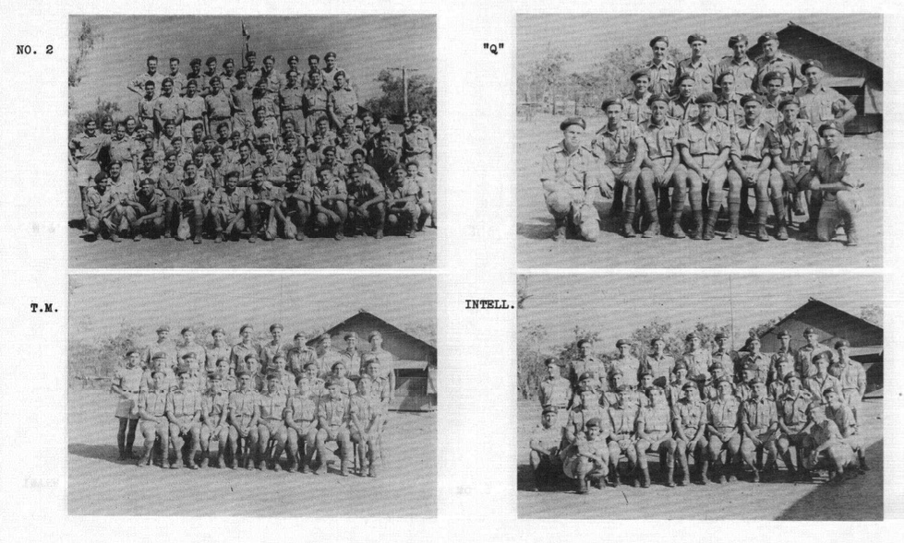

1st Canadian Special Wireless Group, Royal Canadian Corps of Signals - 1944
DETECT
DECODE
DEPLOY

Slide 3


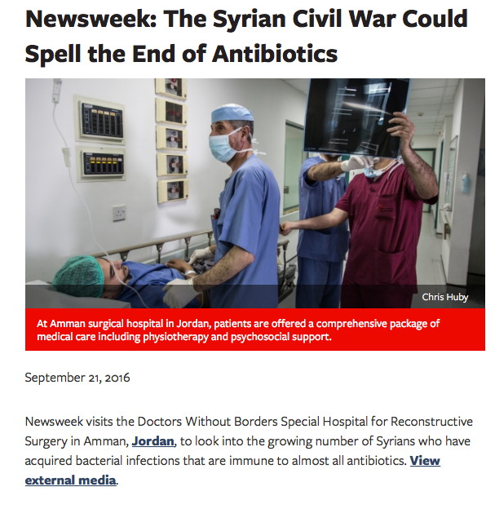


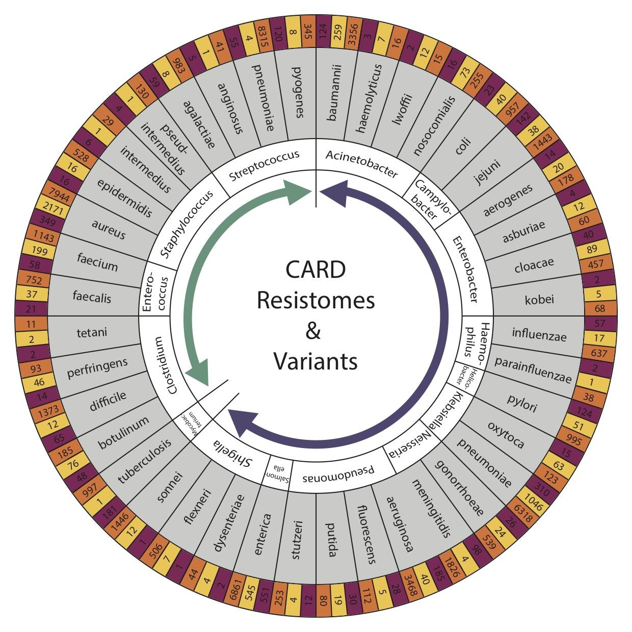


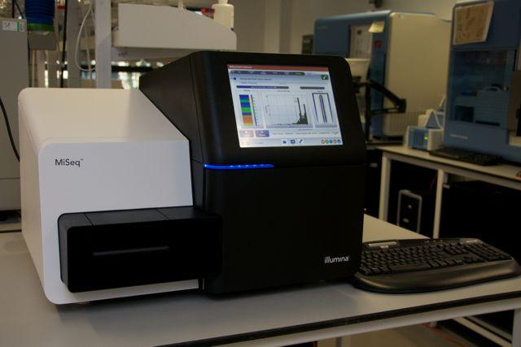
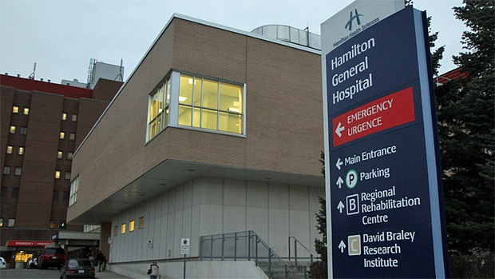

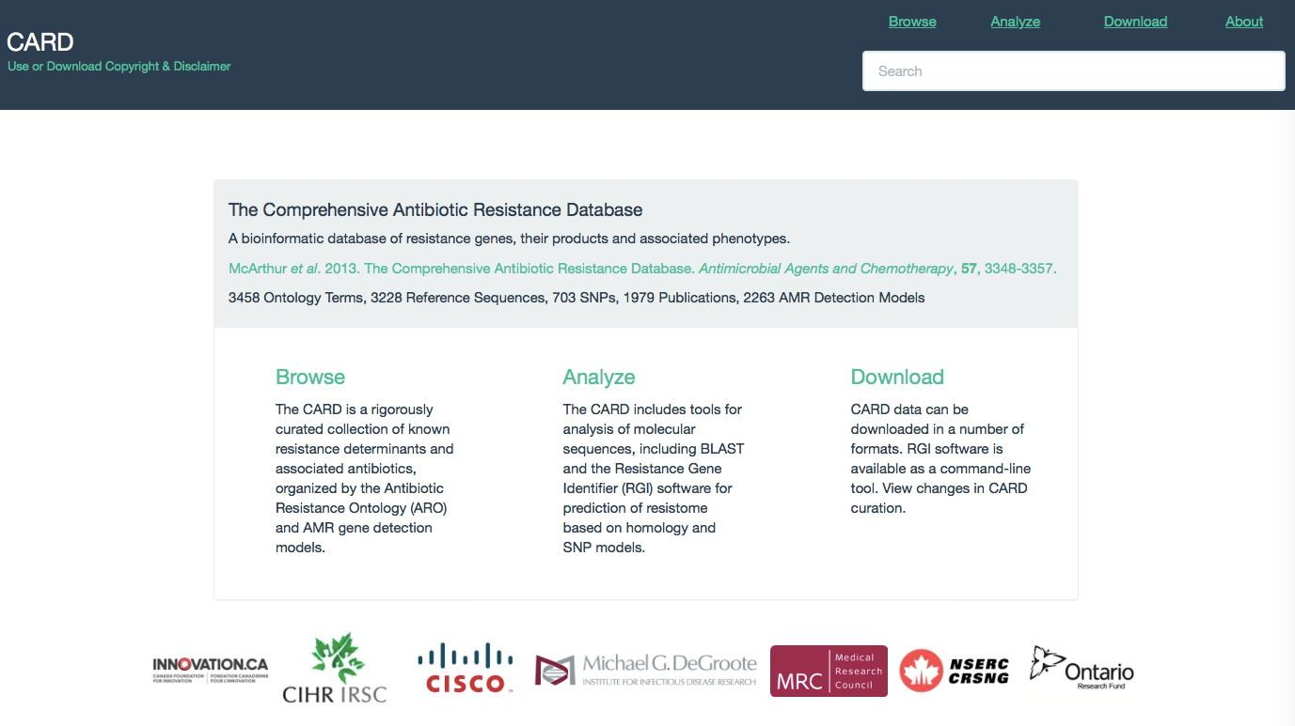
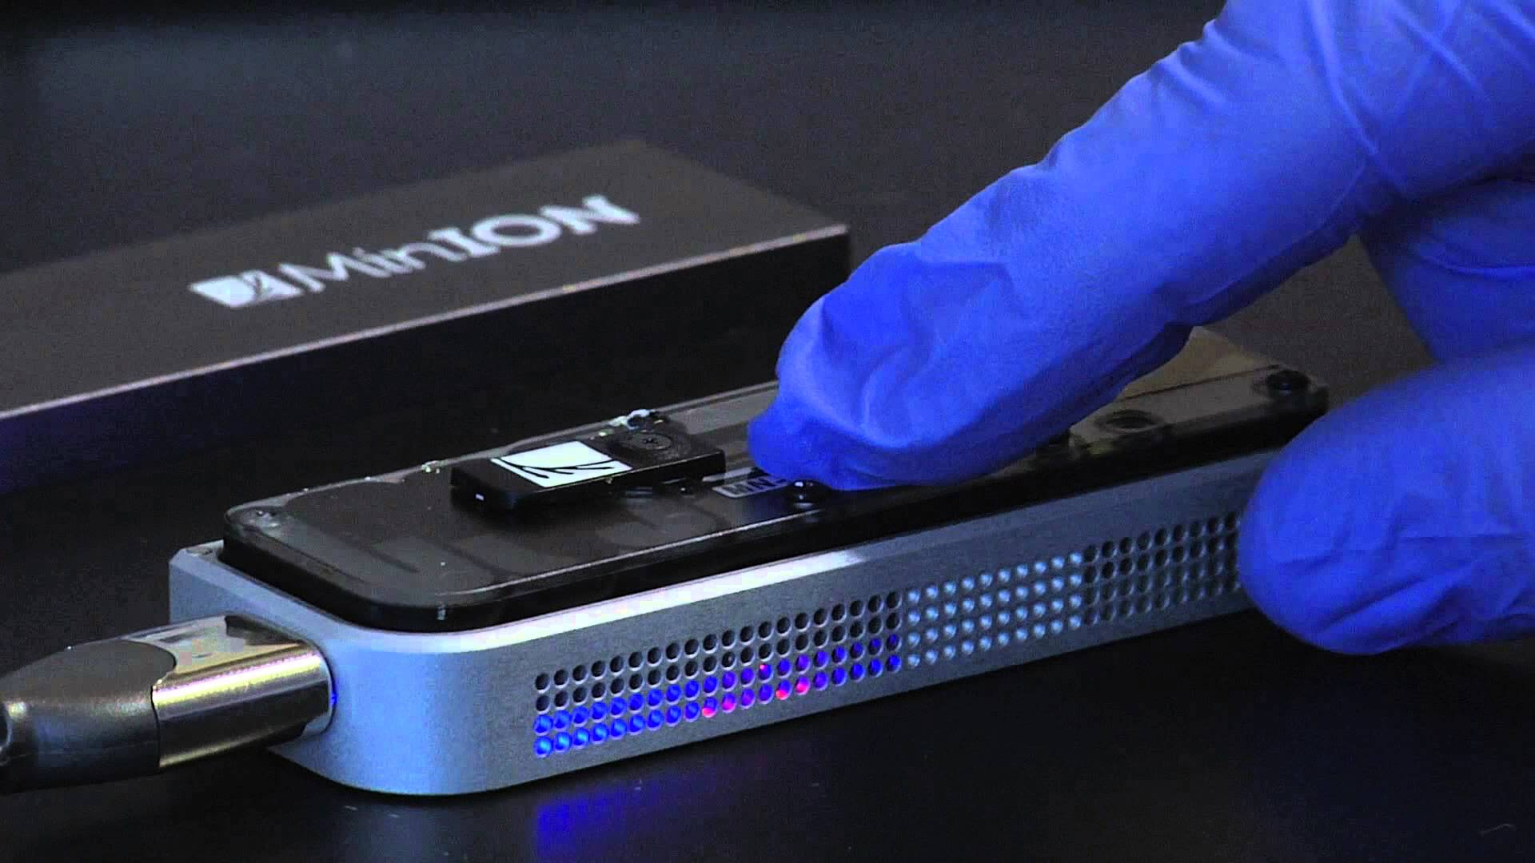
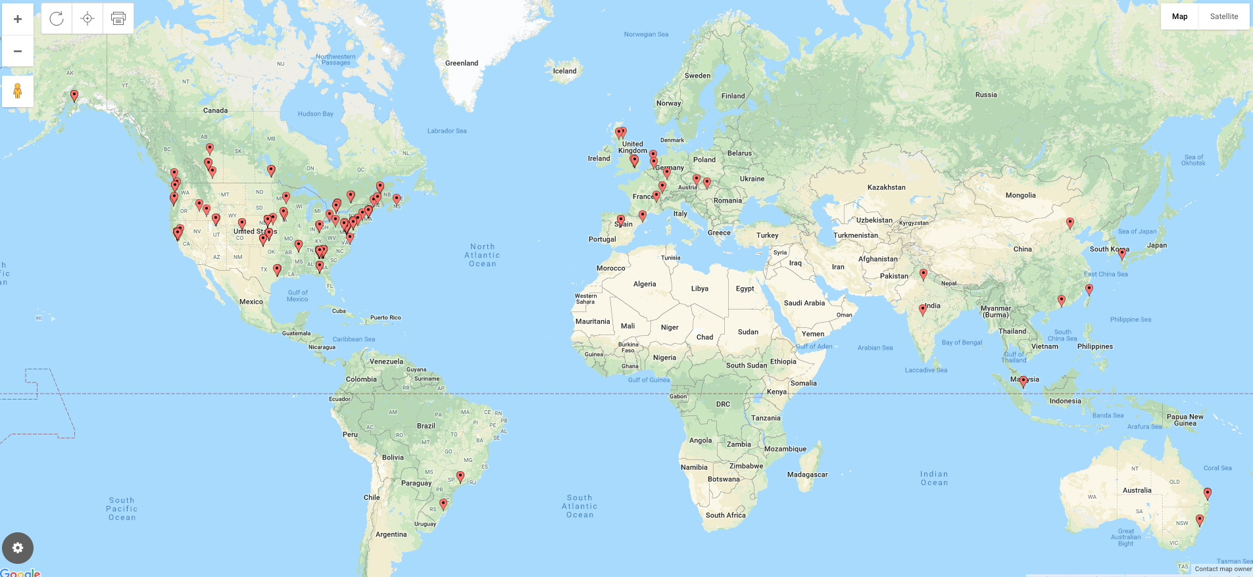
Antimicrobial Resistance
Analytics
Bioinformatics
DNA Sequencing
Biocuration
Public Health Agency Usage 2019
DETECT
DECODE
DEPLOY
patient
community
national & international
diagnostics
outbreaks
surveillance

Slide 4
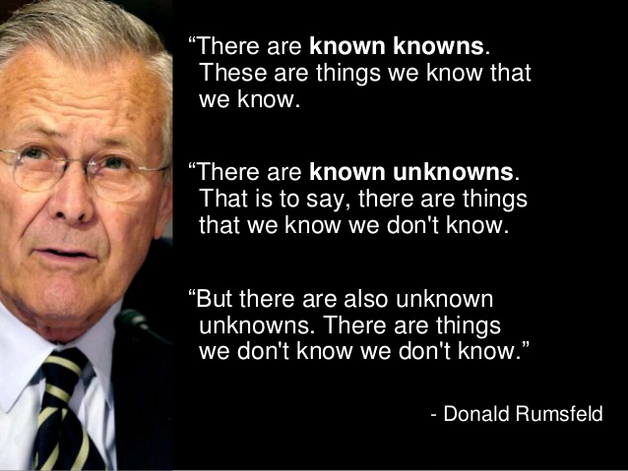
Donald Rumsfeld (US Secretary of Defense 1975-1977, 2001-2006)

Slide 5


Slide 6
genome sequencing!
Genes & Pathogens we are tracking
Characterized genes & pathogens we don’t routinely track; variants of known genes; novel mutations
Emergent threats

Slide 7
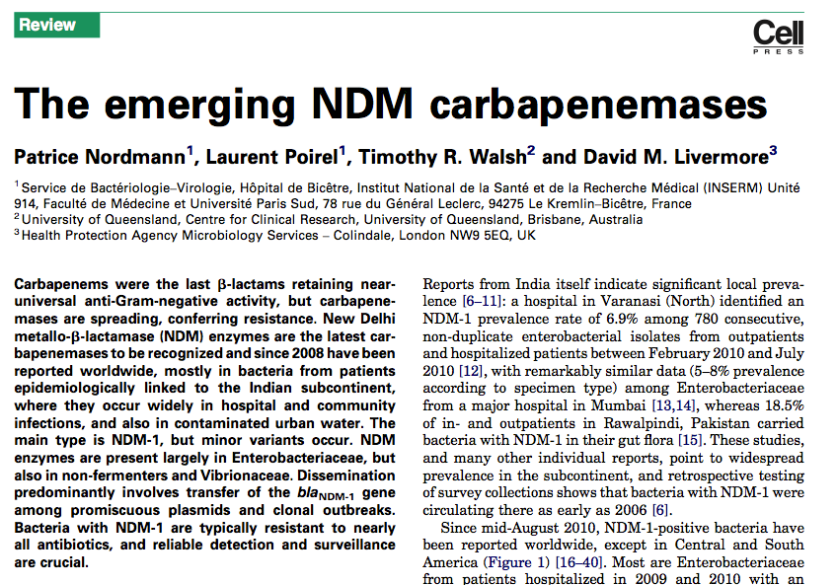
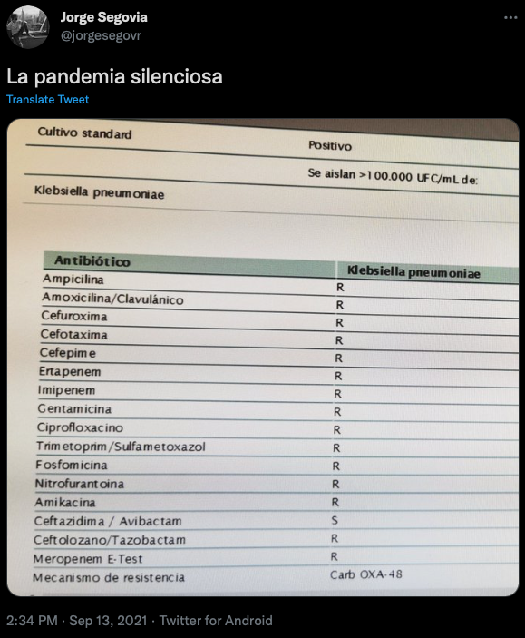

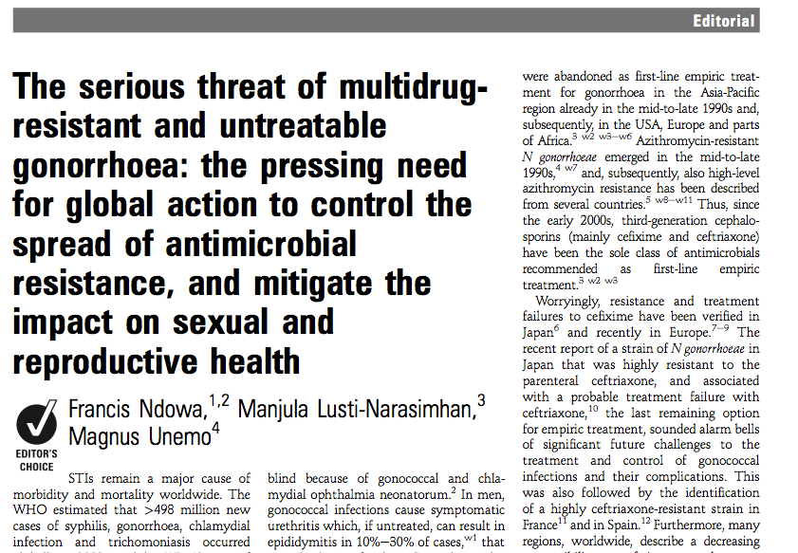
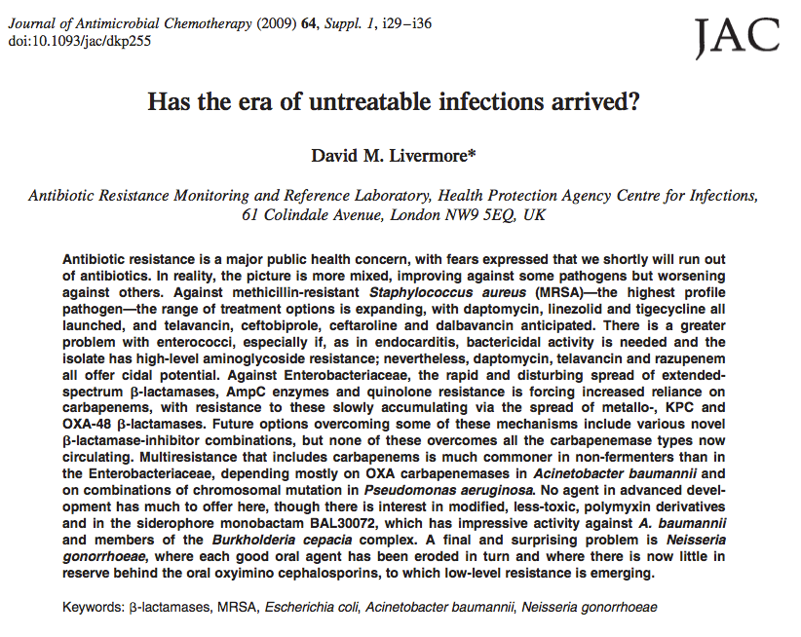
Bacteria are evolving drug resistance faster than we can discover new drugs

Slide 8

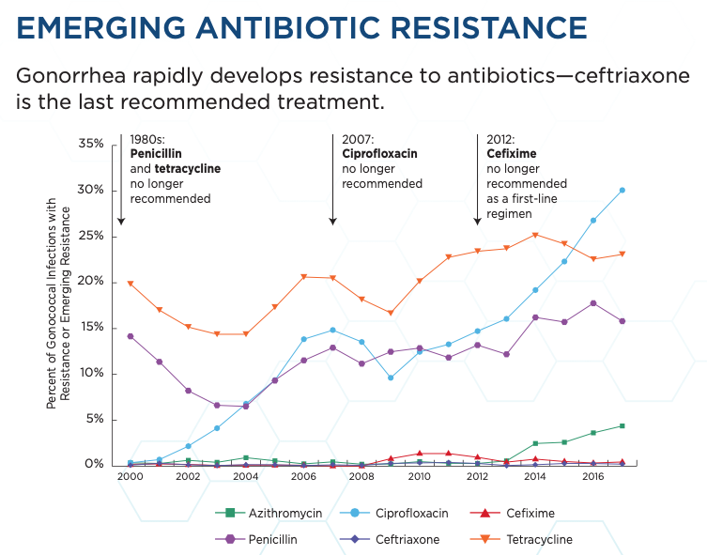
Bacteria are evolving drug resistance faster than we can discover new drugs
CDC’s Antibiotic Resistance Threats in the United States, 2019 https://www.cdc.gov/drugresistance/

Slide 9
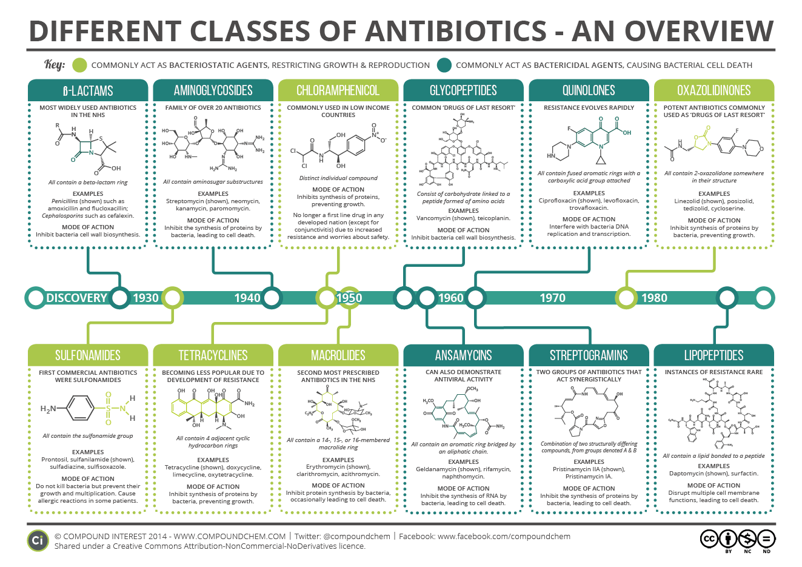

Slide 10
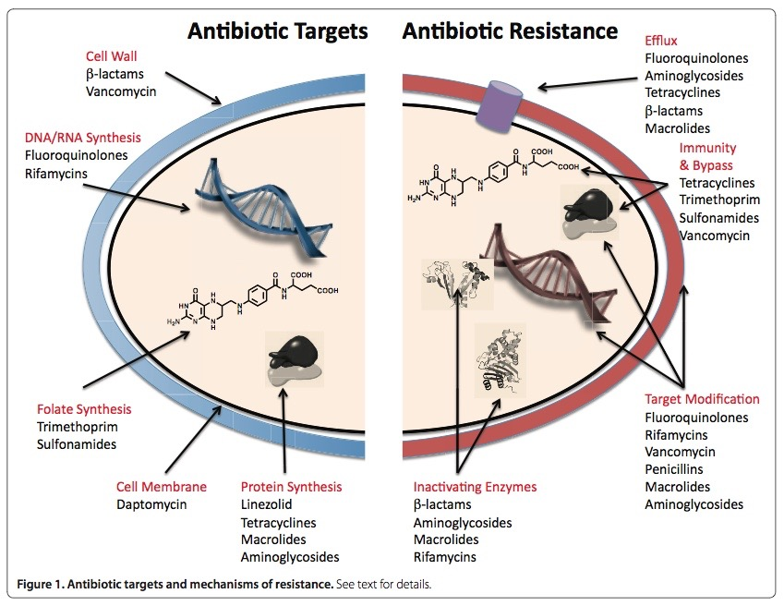
Wright, BMC Biology 2010 8:123

Slide 11
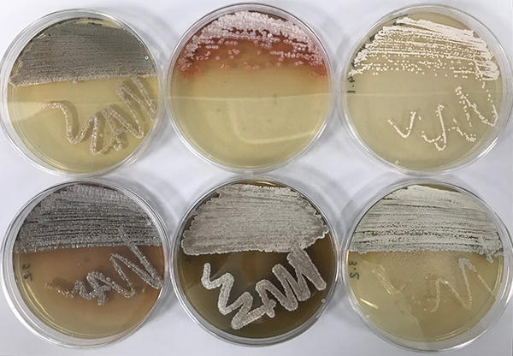

Slide 12
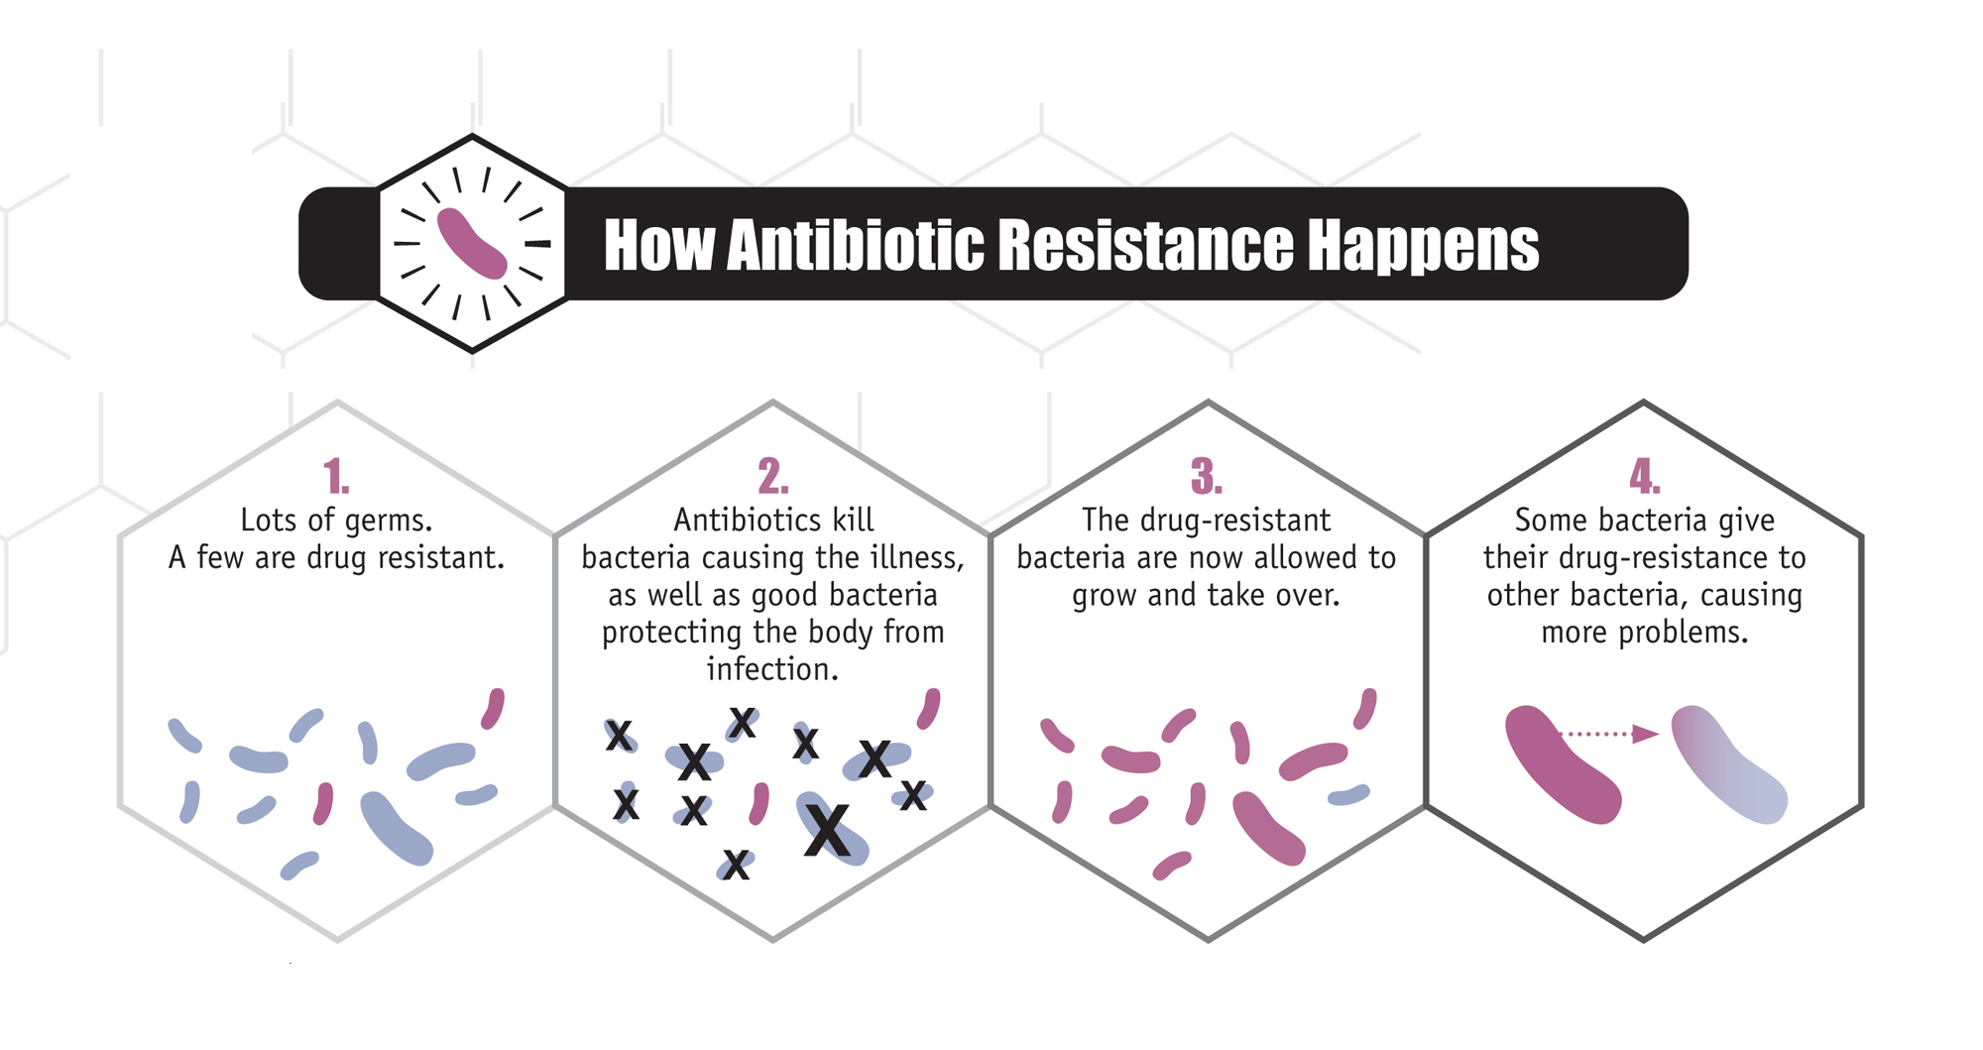
Overuse and Misuse increase Drug Resistance
Infographic: CDC

Slide 13
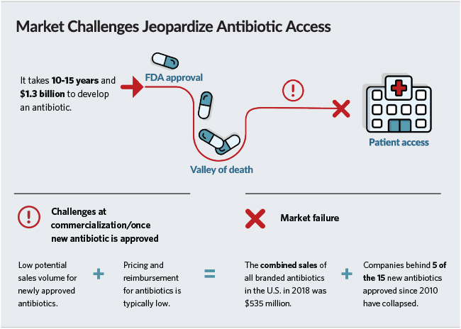
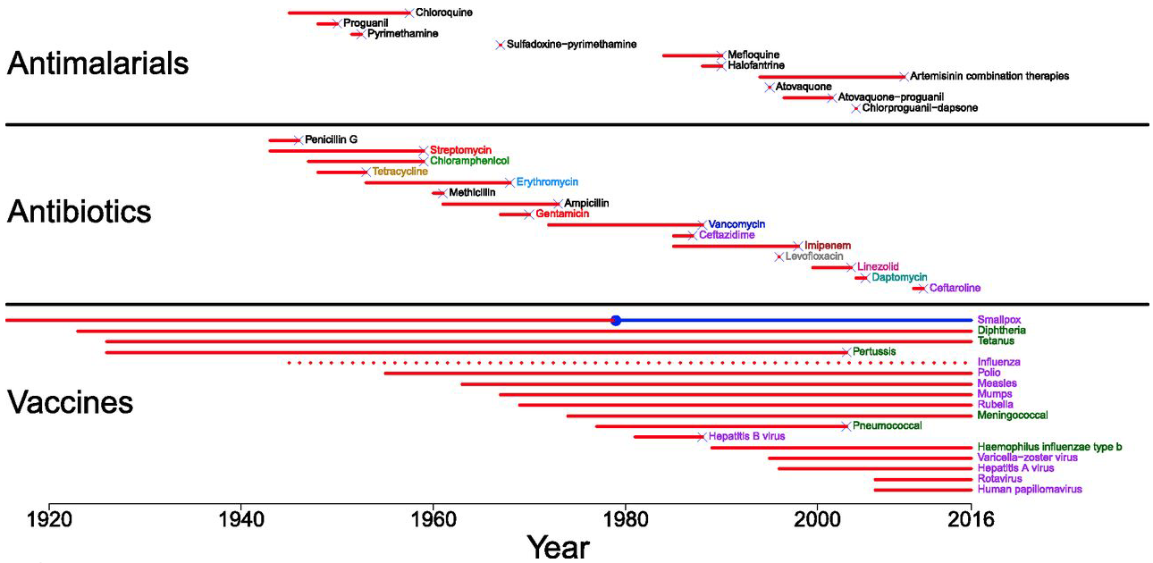
Economic Challenges
www.pewtrusts.org
Kennedy & Read. PNAS 2018 115:12878-12886

Slide 14
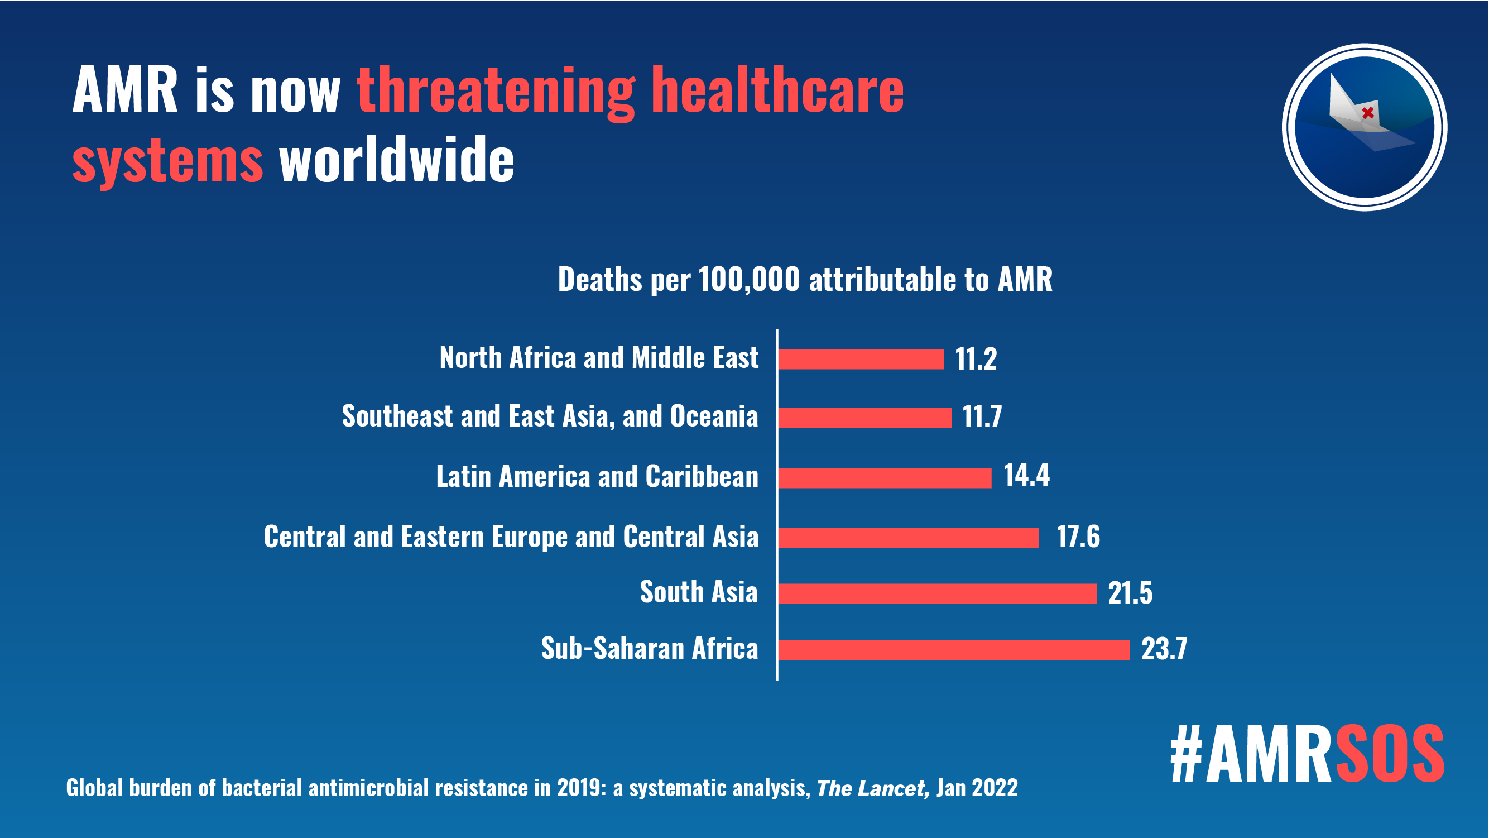
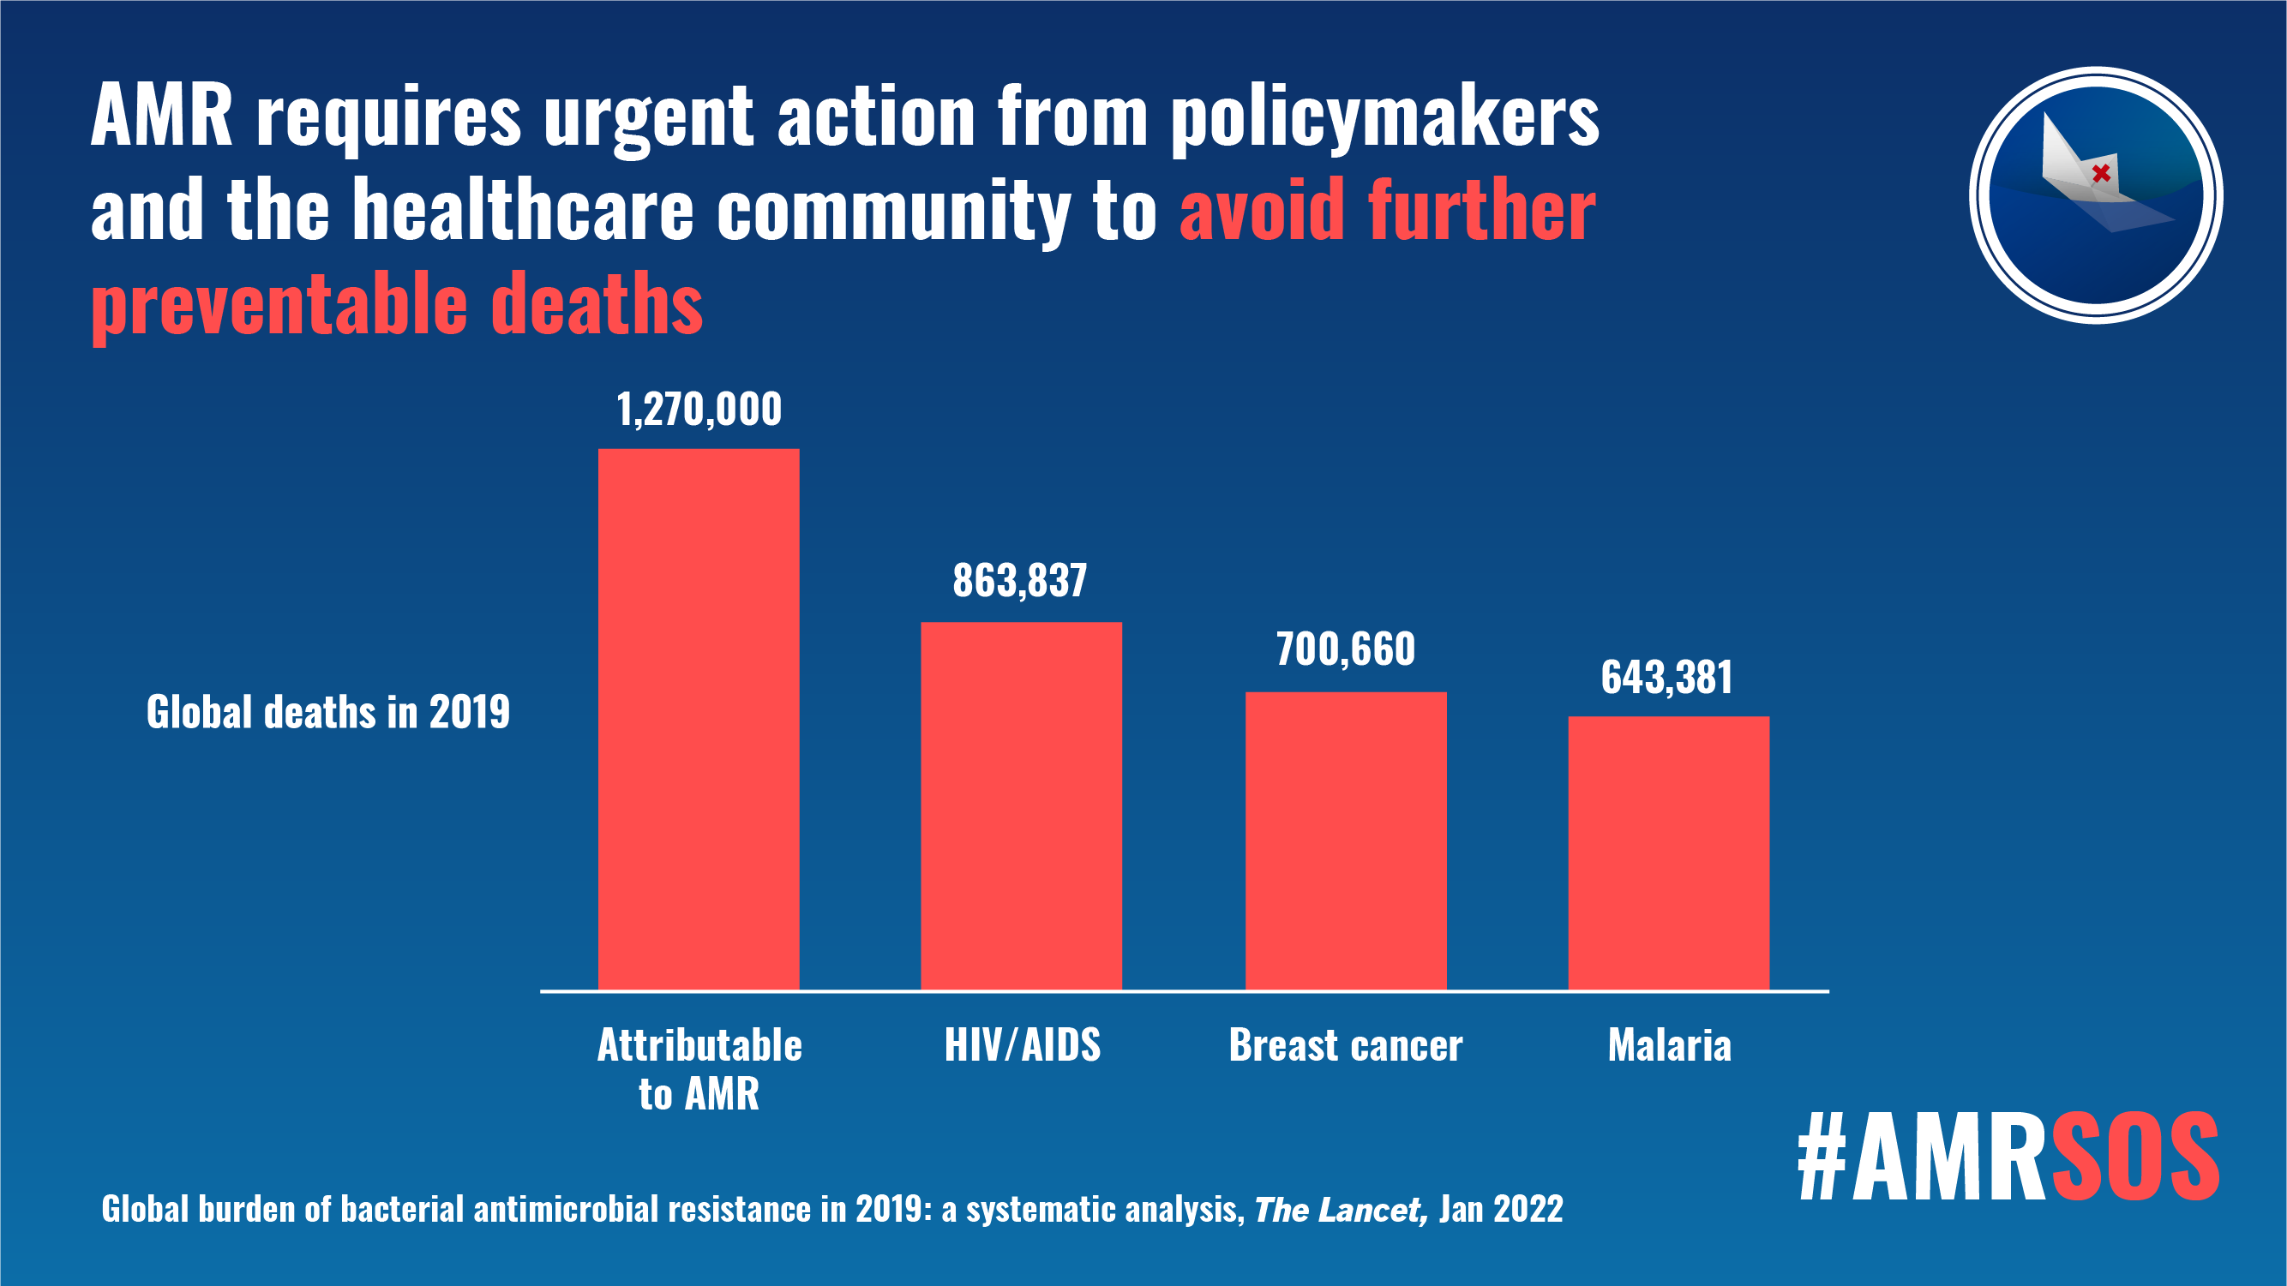
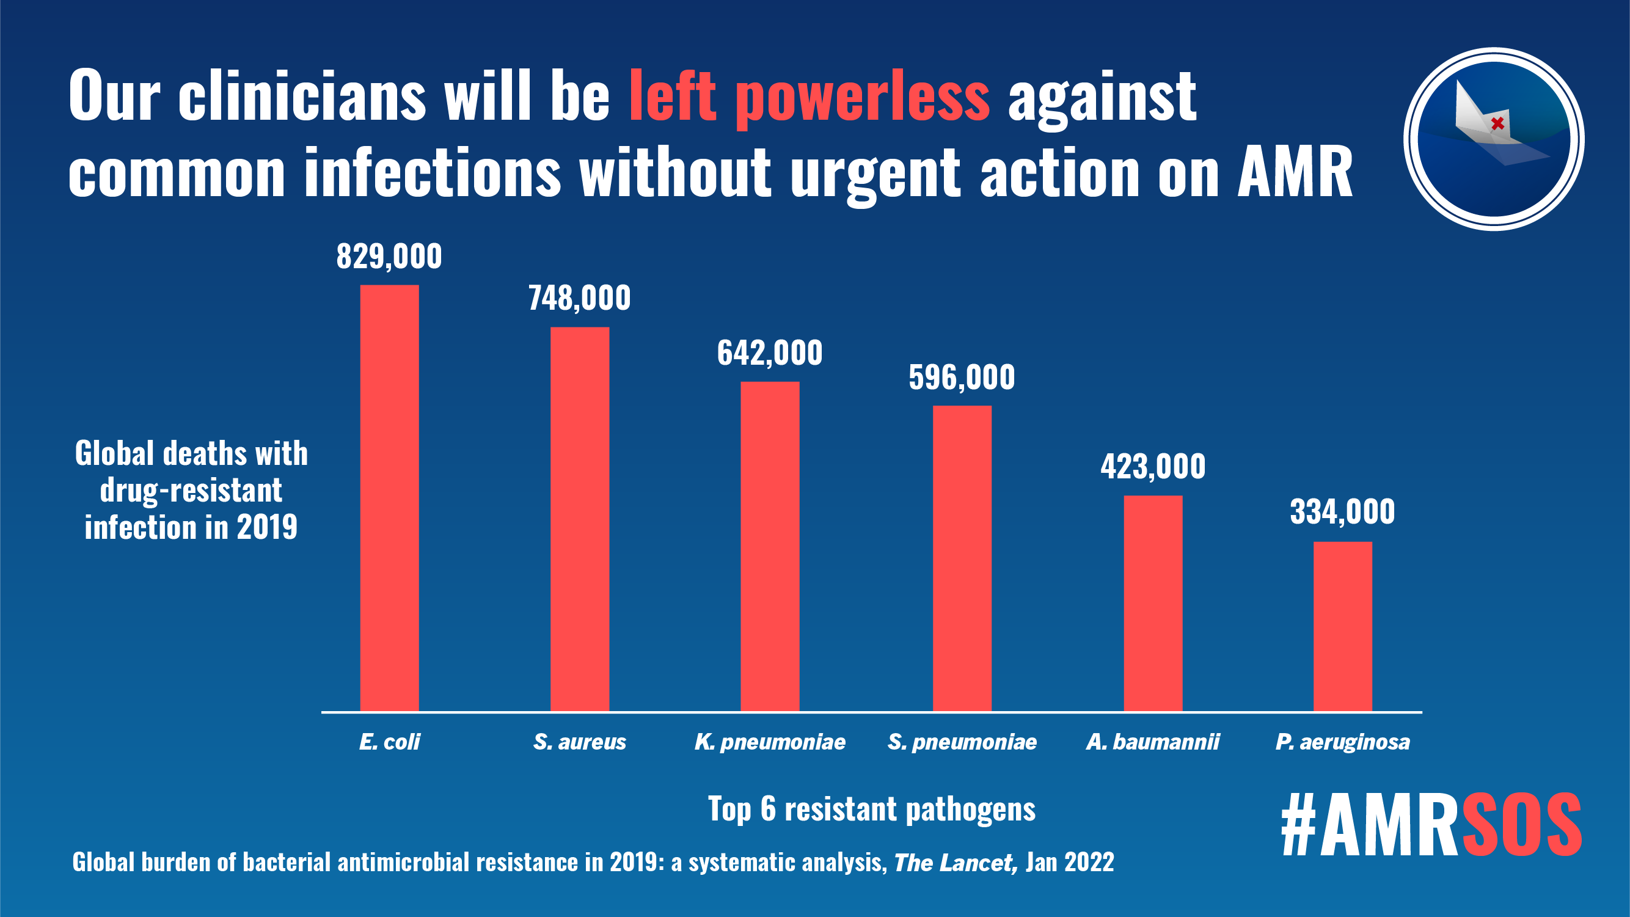
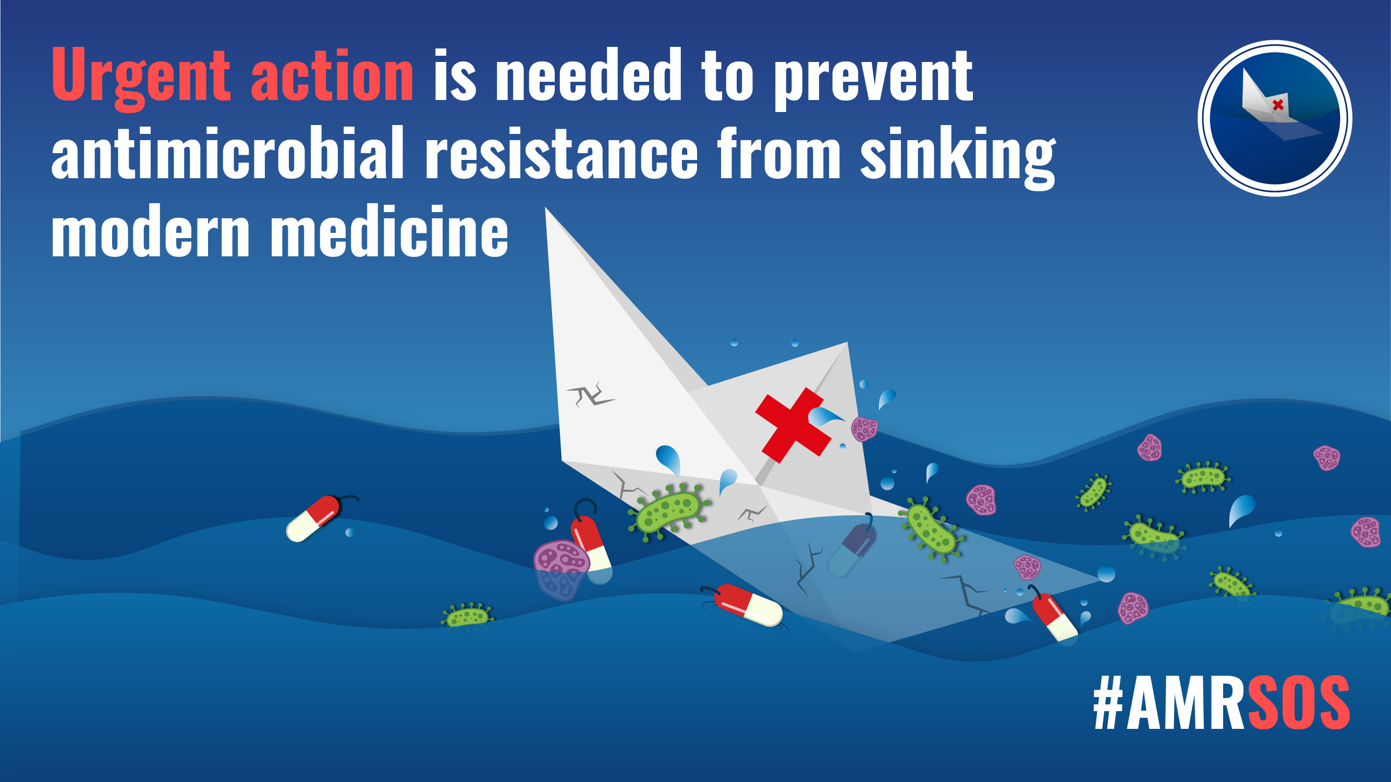
A threat to all of modern medicine
Murray et al. 2022. Global burden of bacterial antimicrobial resistance in 2019: a systematic analysis. Lancet 399, 629-655.

Slide 15
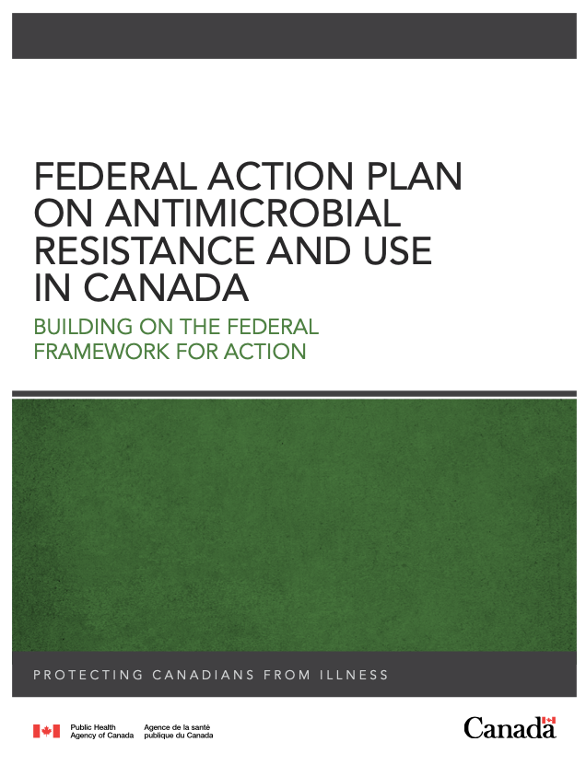
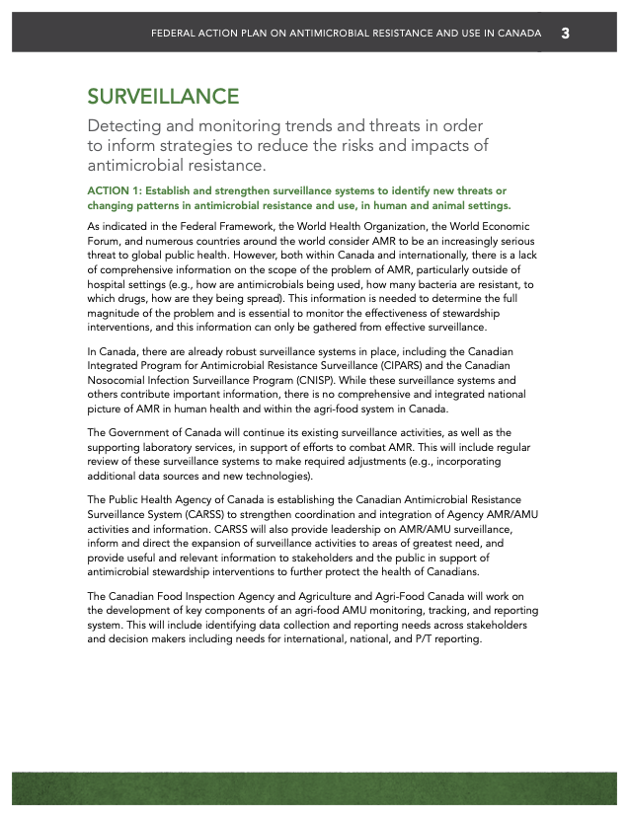
Phenotypic & Genotypic Surveillance is a National & International Priority

Slide 16
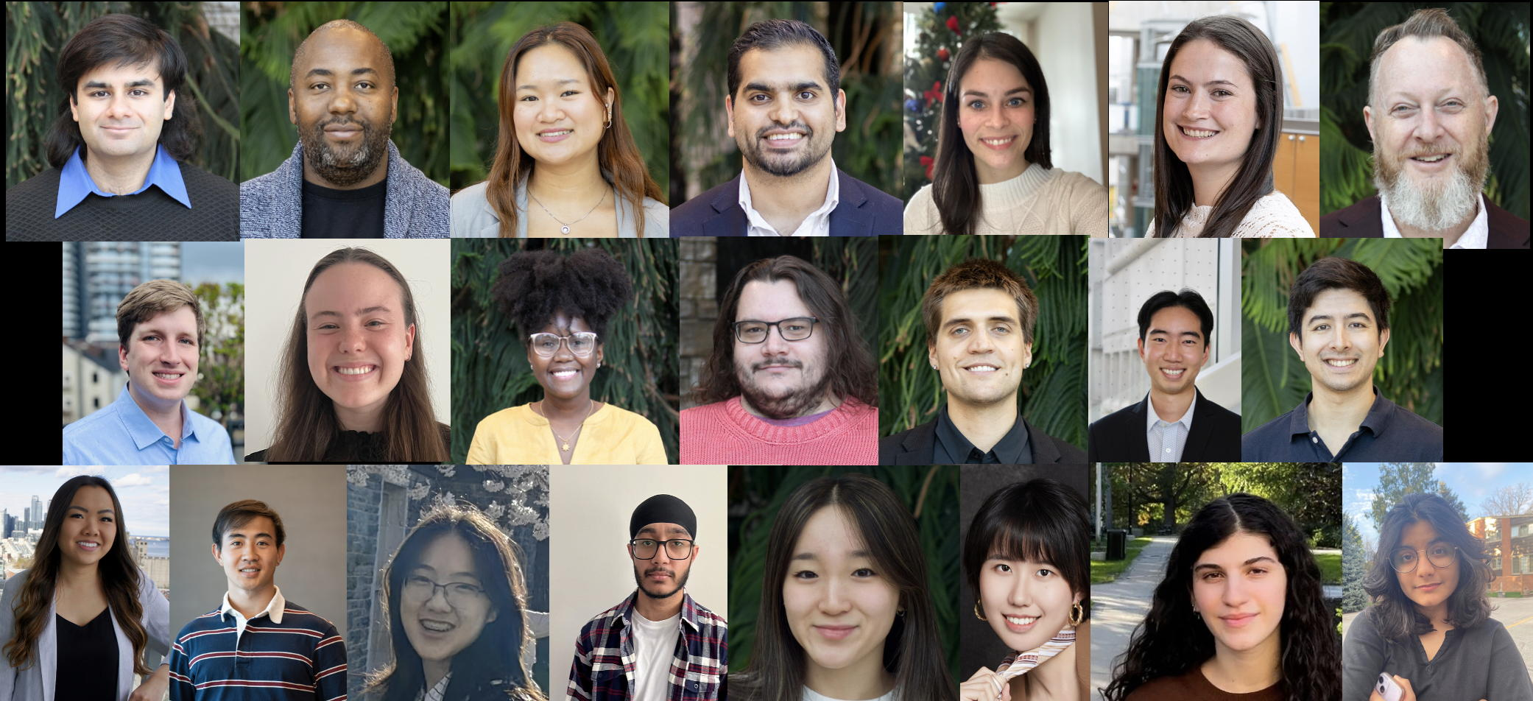
Which resistance genes are in Canada, the Americas, Globally?
Which genes are moving around?
Which pose a threat?

Slide 17
DNA Sequencing – Resistance Genes Can No Longer Hide
DNA sequencing
comparison to reference sequences
prediction of
resistome; AMR surveillance
prediction of phenotype; clinical decision making; risk assessment

Slide 18
DNA Sequencing – Resistance Genes Can No Longer Hide
DNA sequencing
comparison to reference sequences
CARD
biocuration
prediction of
resistome; AMR surveillance
Resistance Gene Identifier
bioinformatics
prediction of phenotype; clinical decision making; risk assessment
Machine Learning
analytics

Slide 19
Biocuration

Slide 20
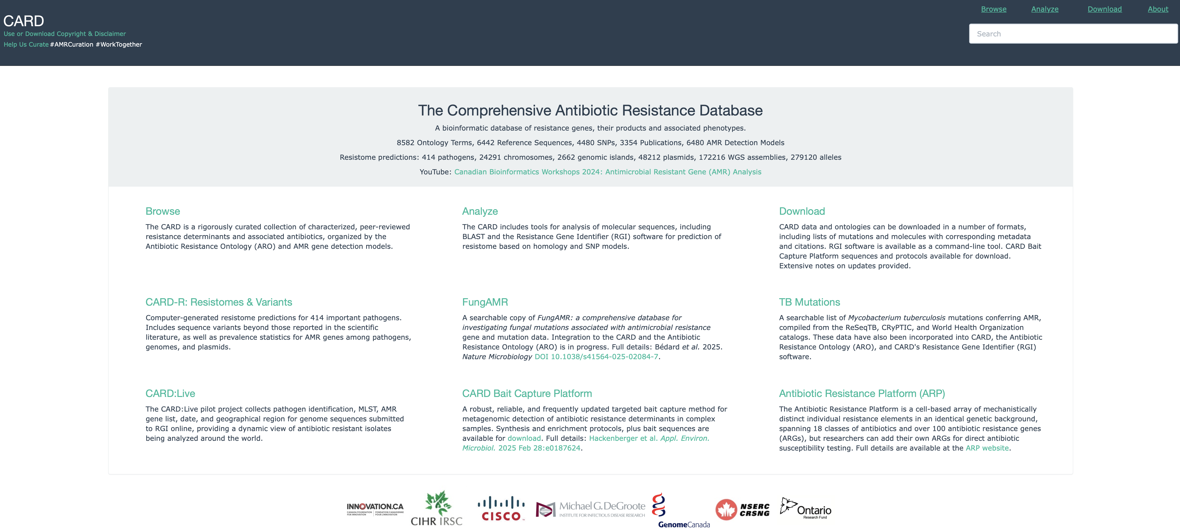
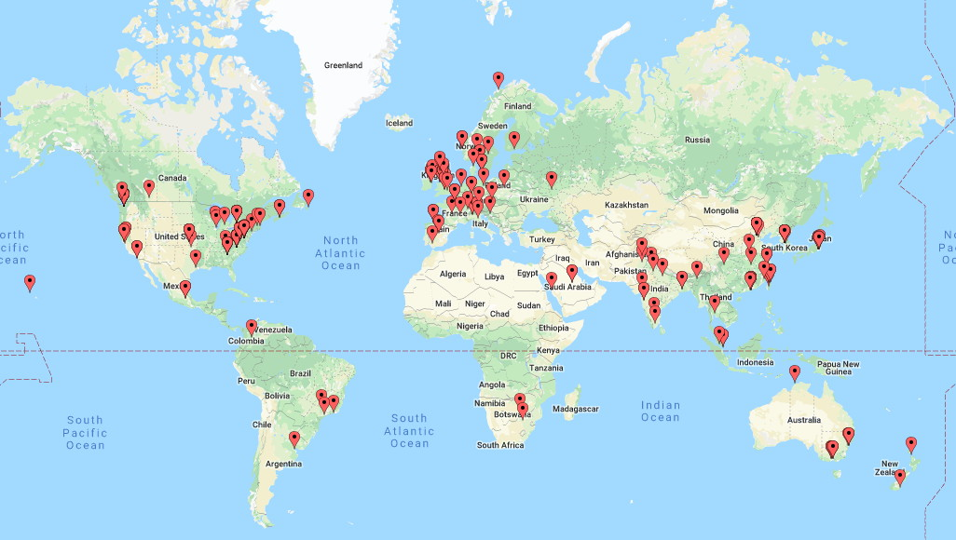
CARD’s primary curation paradigm
Peer reviewed publication in PubMed
Clear experimental evidence of elevated MIC
Public sequence record in GenBank
7 days in the life of CARD…
Alcock et al. CARD 2023: Expanded Curation, Support for Machine Learning, and Resistome Prediction at the Comprehensive Antibiotic Resistance Database. Nucleic Acids Research, in press.

Slide 21
CARD’s primary curation paradigm
Peer reviewed publication in PubMed
Clear experimental evidence of elevated MIC
Public sequence record in GenBank
7 days in the life of CARD…
Alcock et al. CARD 2023: Expanded Curation, Support for Machine Learning, and Resistome Prediction at the Comprehensive Antibiotic Resistance Database. Nucleic Acids Research, in press.

Slide 22
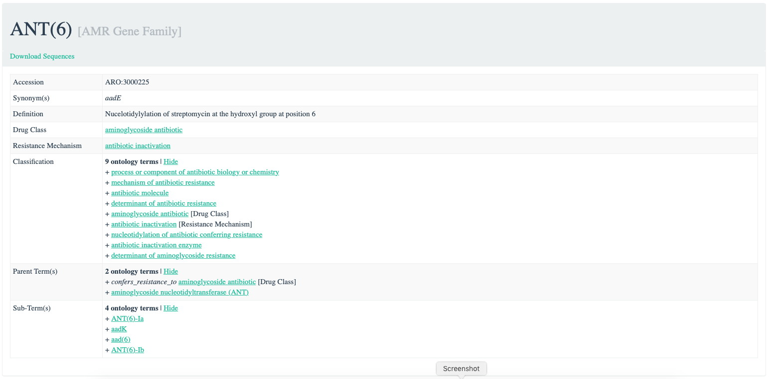
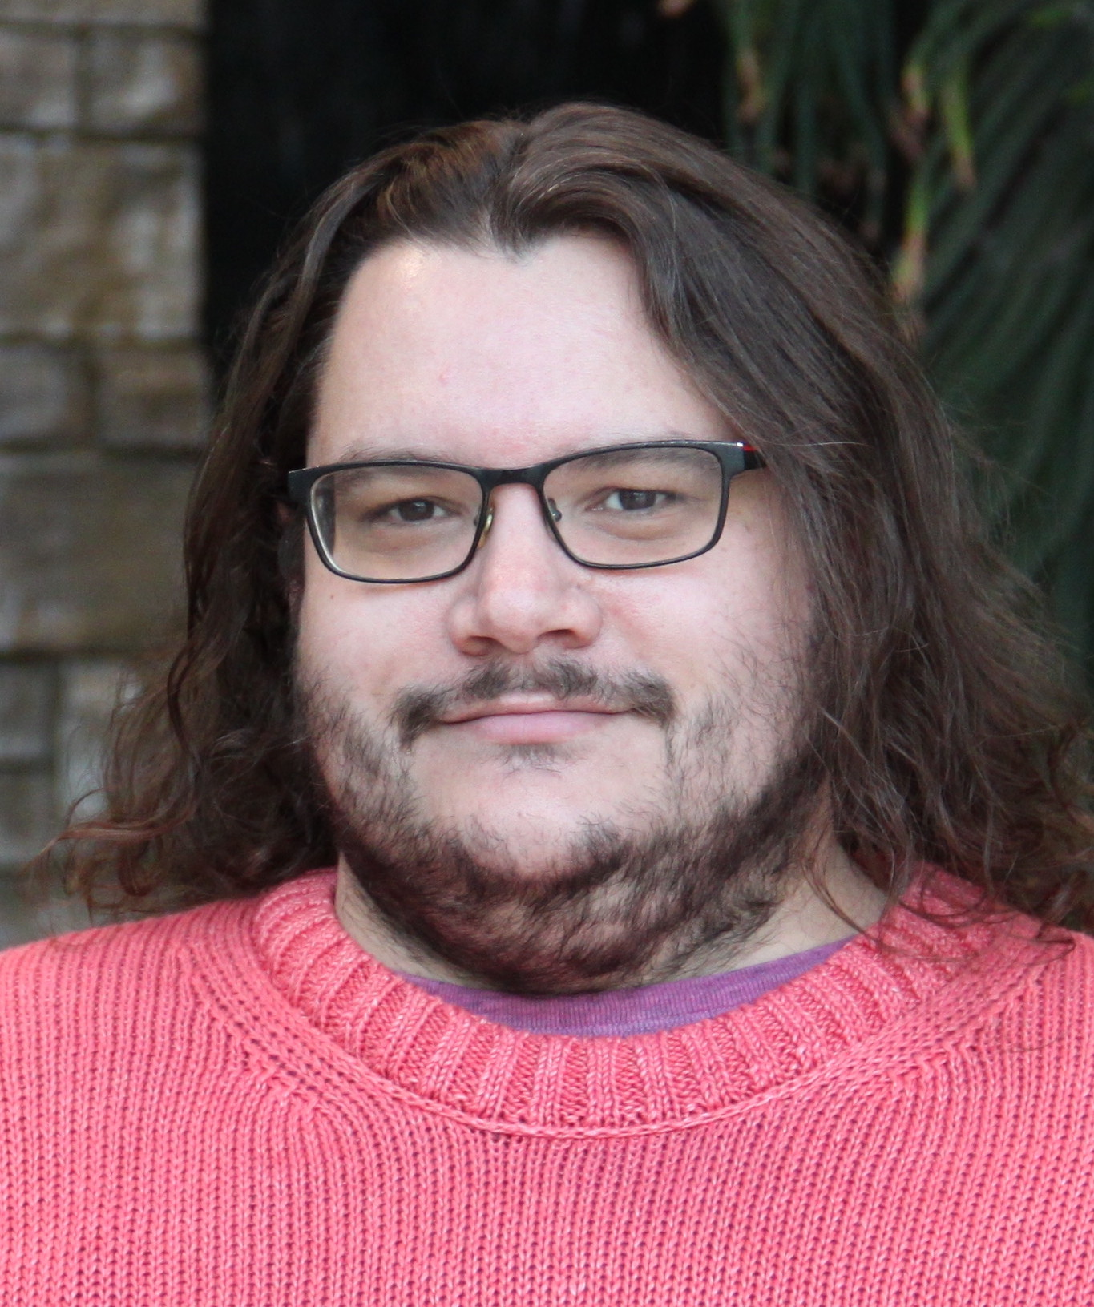
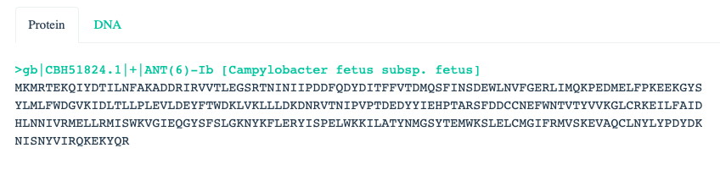
Comprehensive Antibiotic Resistance Database
card.mcmaster.ca
Brian Alcock, Lead CARD Curator
Antibiotic Resistance Ontology knowledgebase

Slide 23
Comprehensive Antibiotic Resistance Database
card.mcmaster.ca
Classification:
AMR Gene Family
Resistance Mechanism
Drug Class
Brian Alcock, Lead CARD Curator
Highly Curated:
AMR Gene Family -> Drug Class
Less Curated:
AMR Gene/Mutation -> Antibiotic, MICs

Slide 24
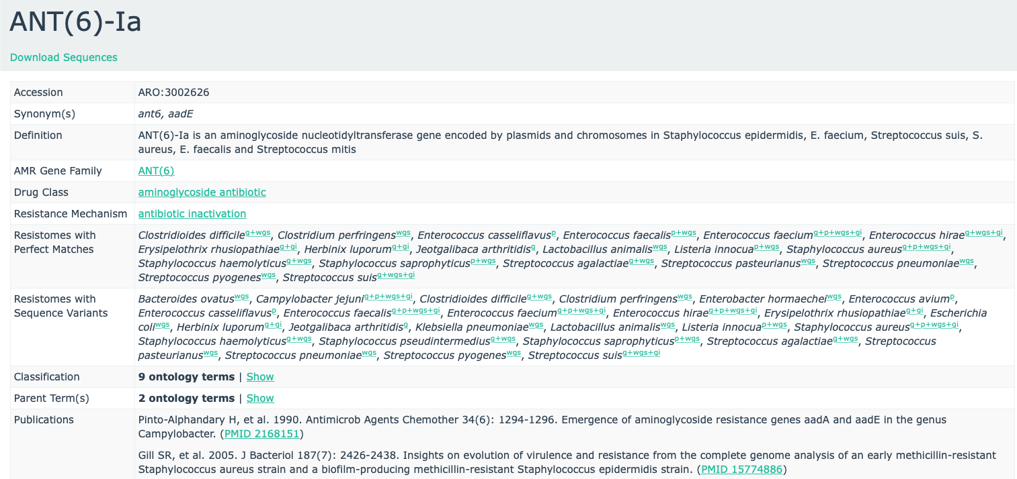
Comprehensive Antibiotic Resistance Database
card.mcmaster.ca
Molecular Epidemiology
in silico prediction of AMR genes, resistomes, and sequence variants
381 pathogens, 24291 chromosomes, 2662 genomic islands, 48212 plasmids, 172216 WGS assemblies, 276270 alleles

Slide 25
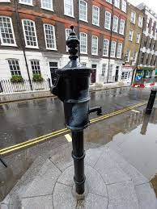
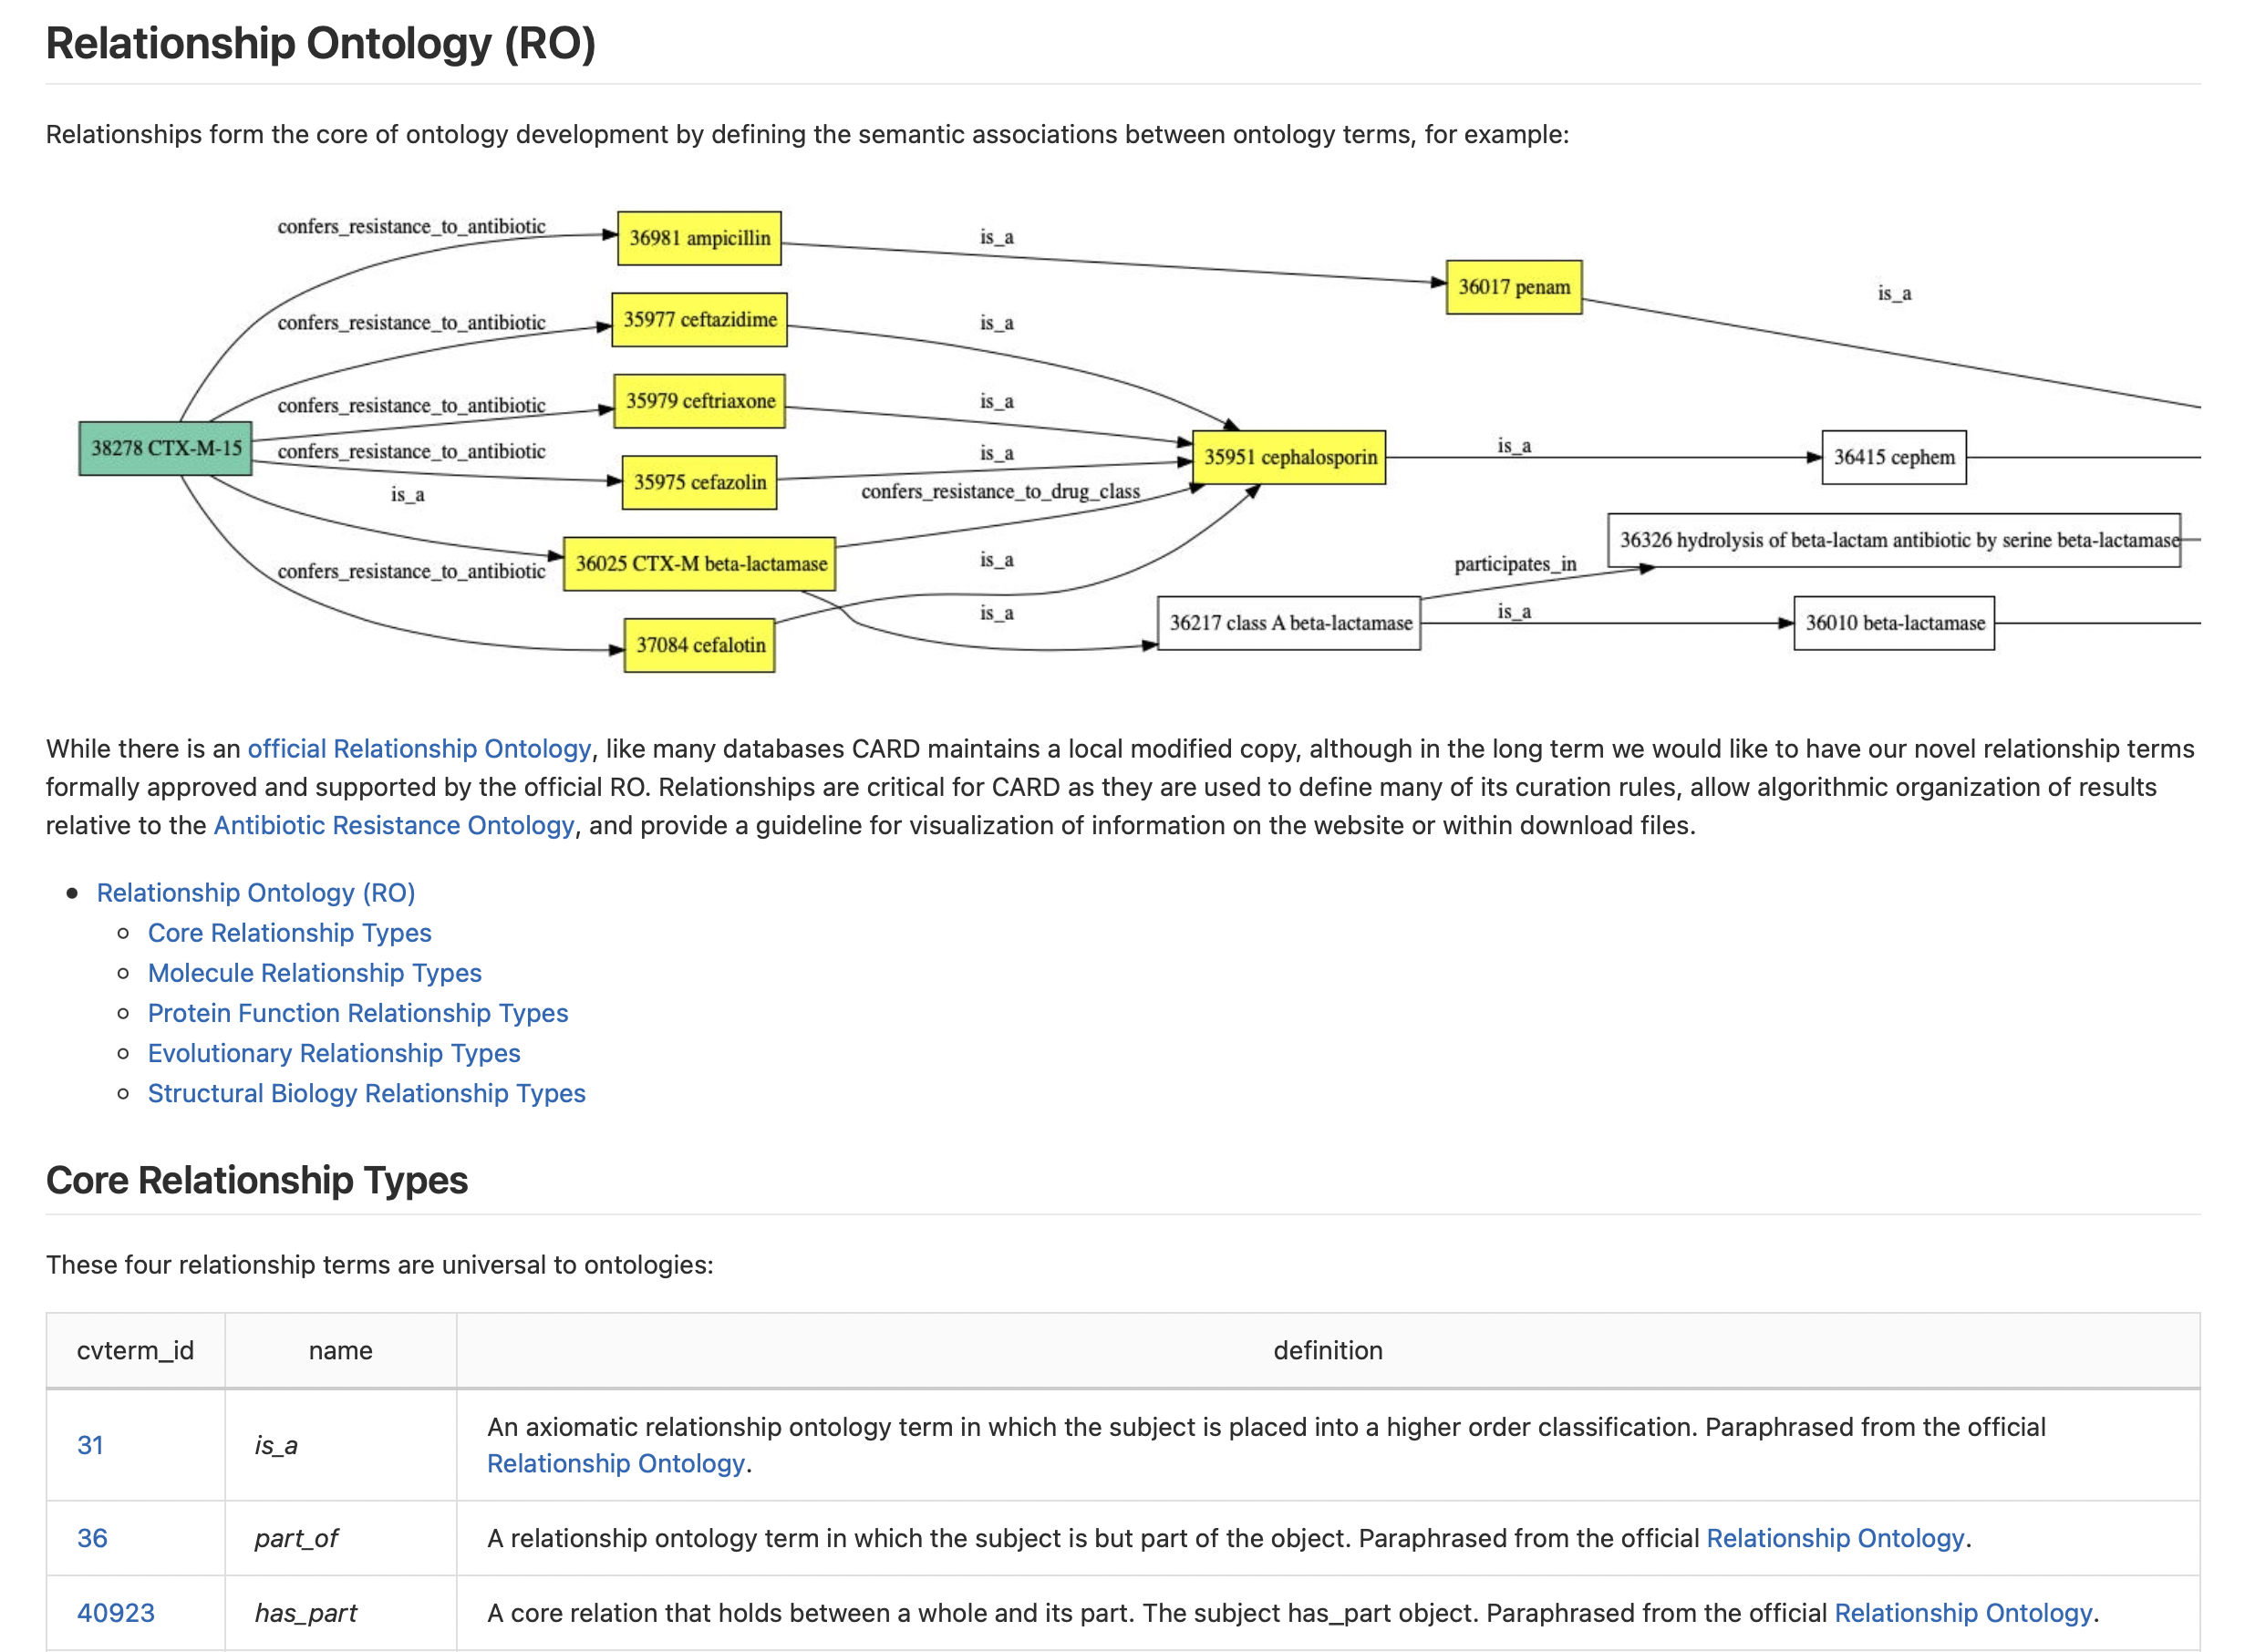

Broad Street Schema has 40M+ rows of data
Frequently Updated
CARD 4.0.1 – May 2025
CARD 4.0.0 – December 2024
CARD 3.3.0 – August 2024
CARD 3.2.9 – February 2024
CARD 3.2.8 – October 2023
CARD 3.2.7 – March 2023
CARD 3.2.6 – January 2023
CARD 3.2.5 – September, 2022
CARD 3.2.4 - July 27, 2022
CARD 3.2.3 - June 14, 2022
CARD 3.2.2 - April 28, 2022
CARD 3.2.1 - April 25, 2022
CARD 3.2.0 - April 4, 2022
…
~204,000 AMR papers in PubMed
~10,000 added AMR papers per year

Slide 26
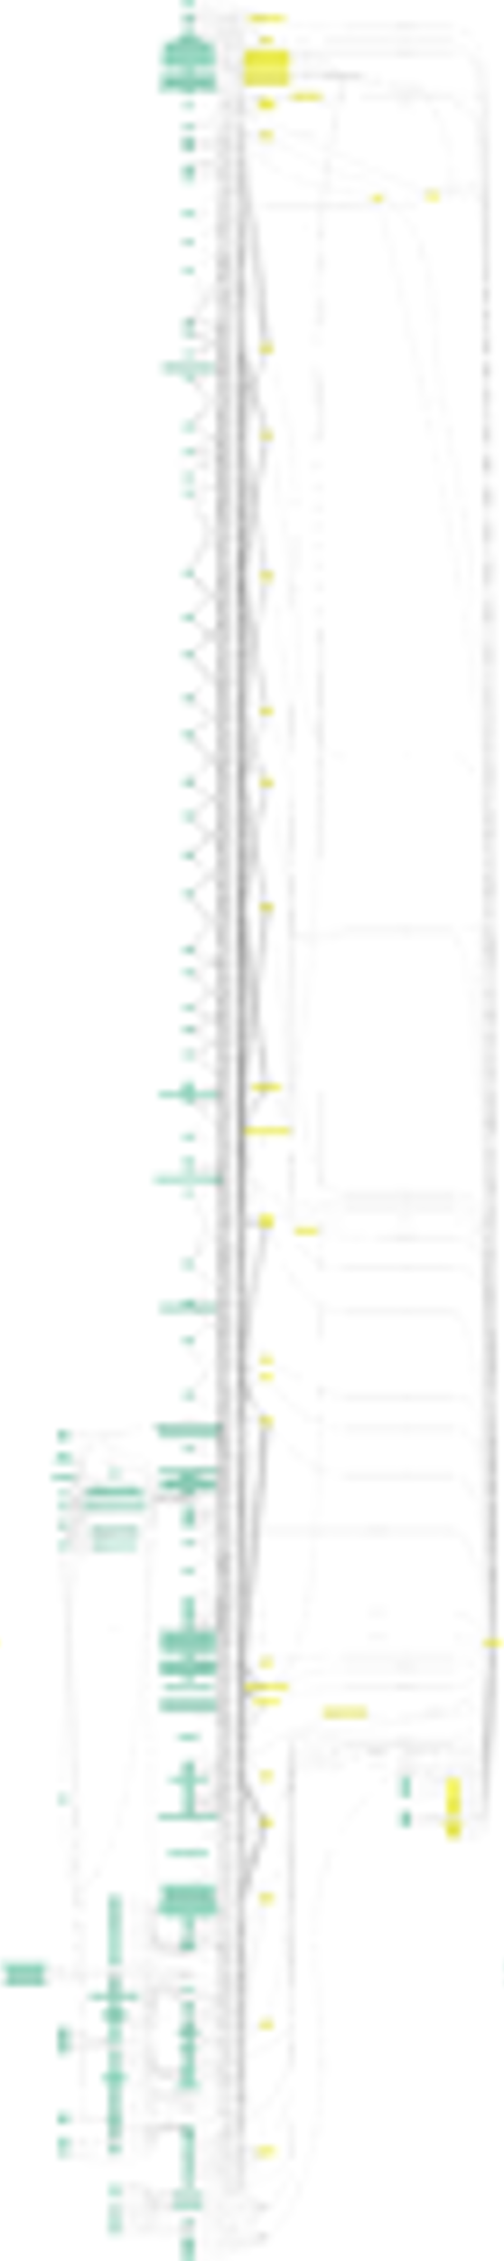
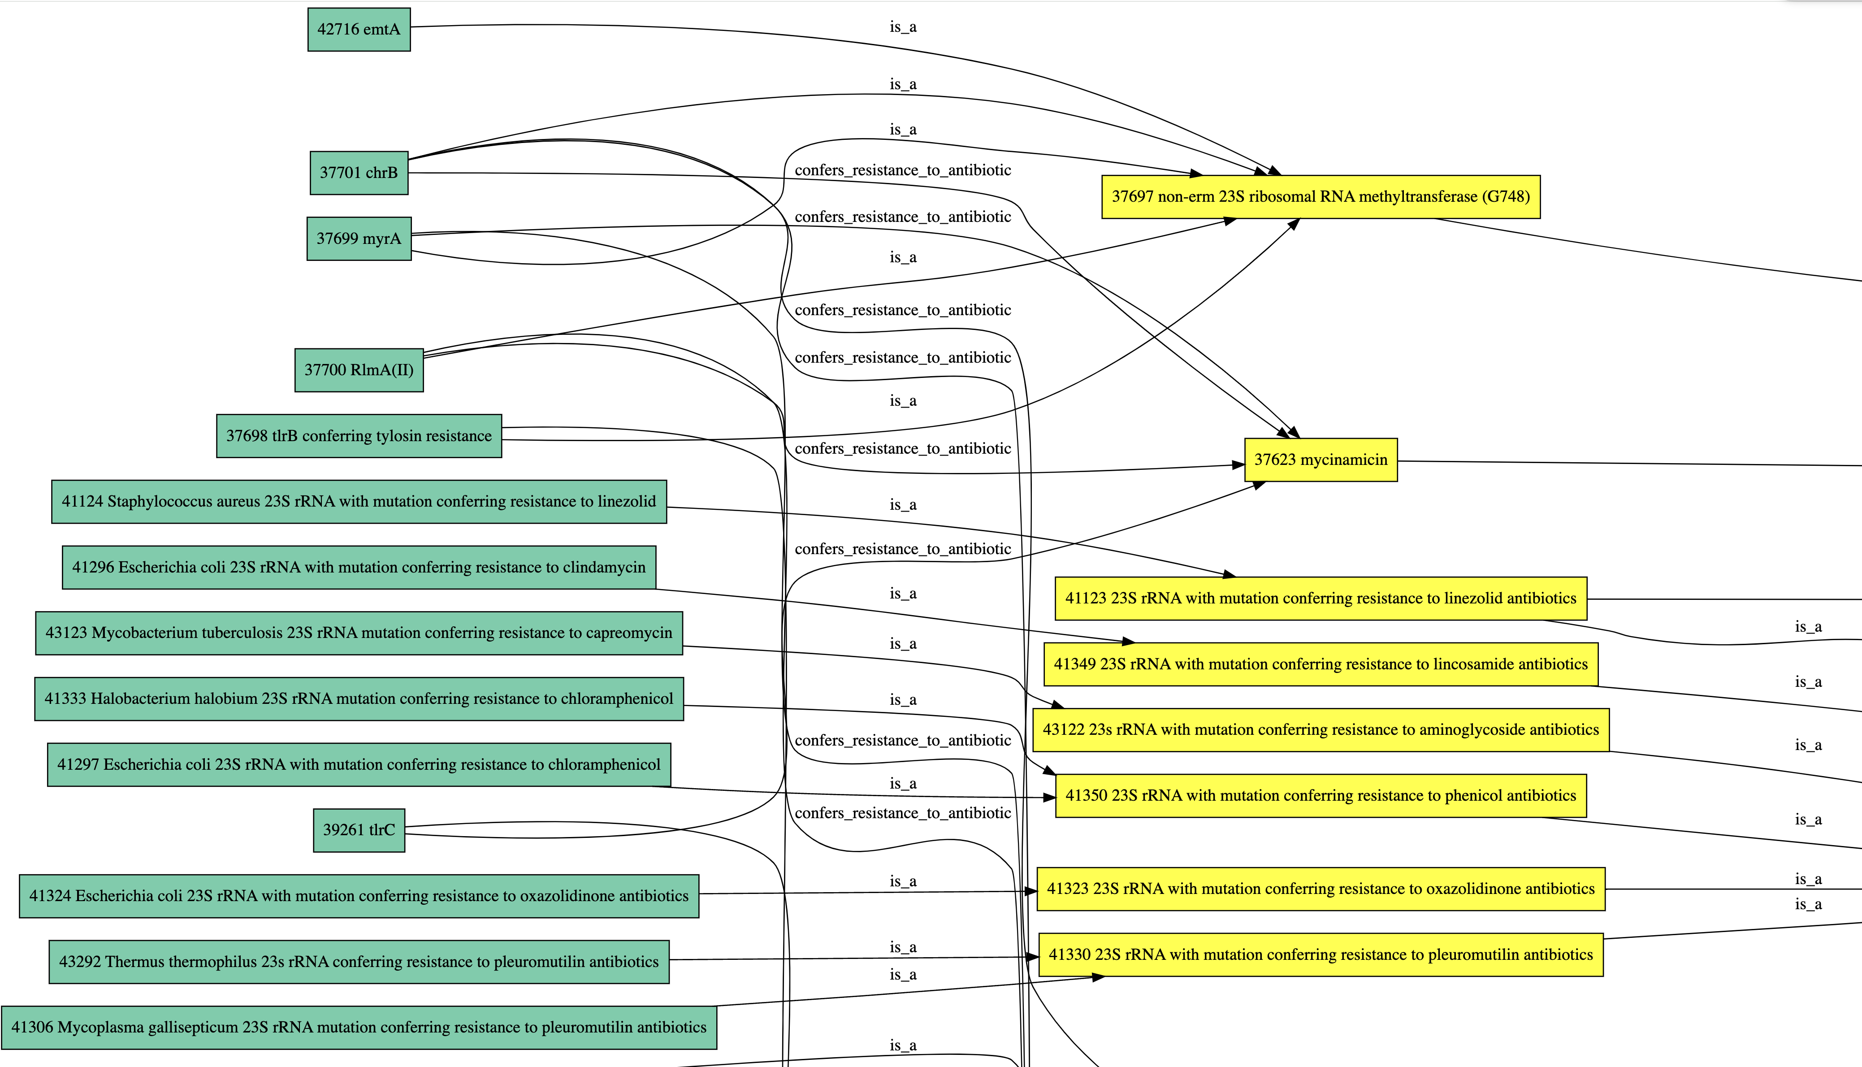
Antibiotic Resistance Ontology

Slide 27


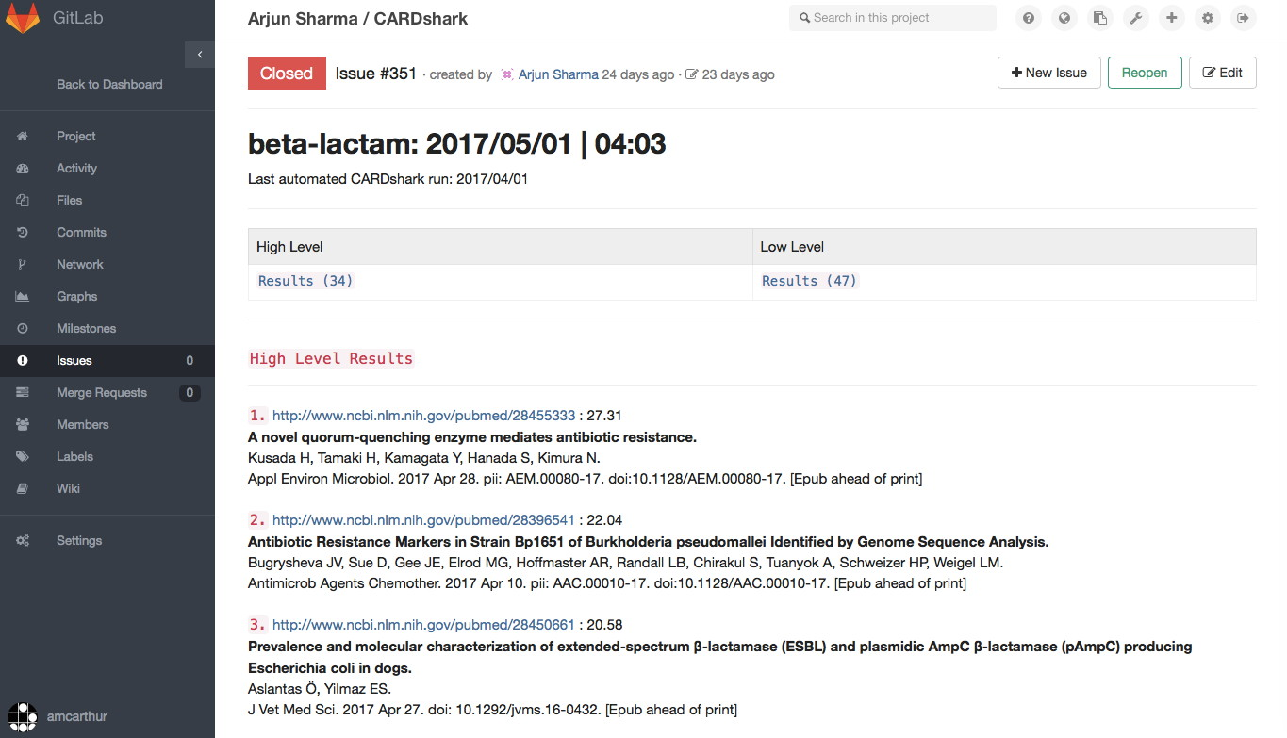
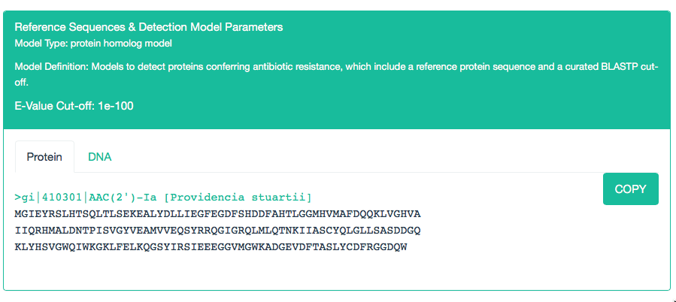
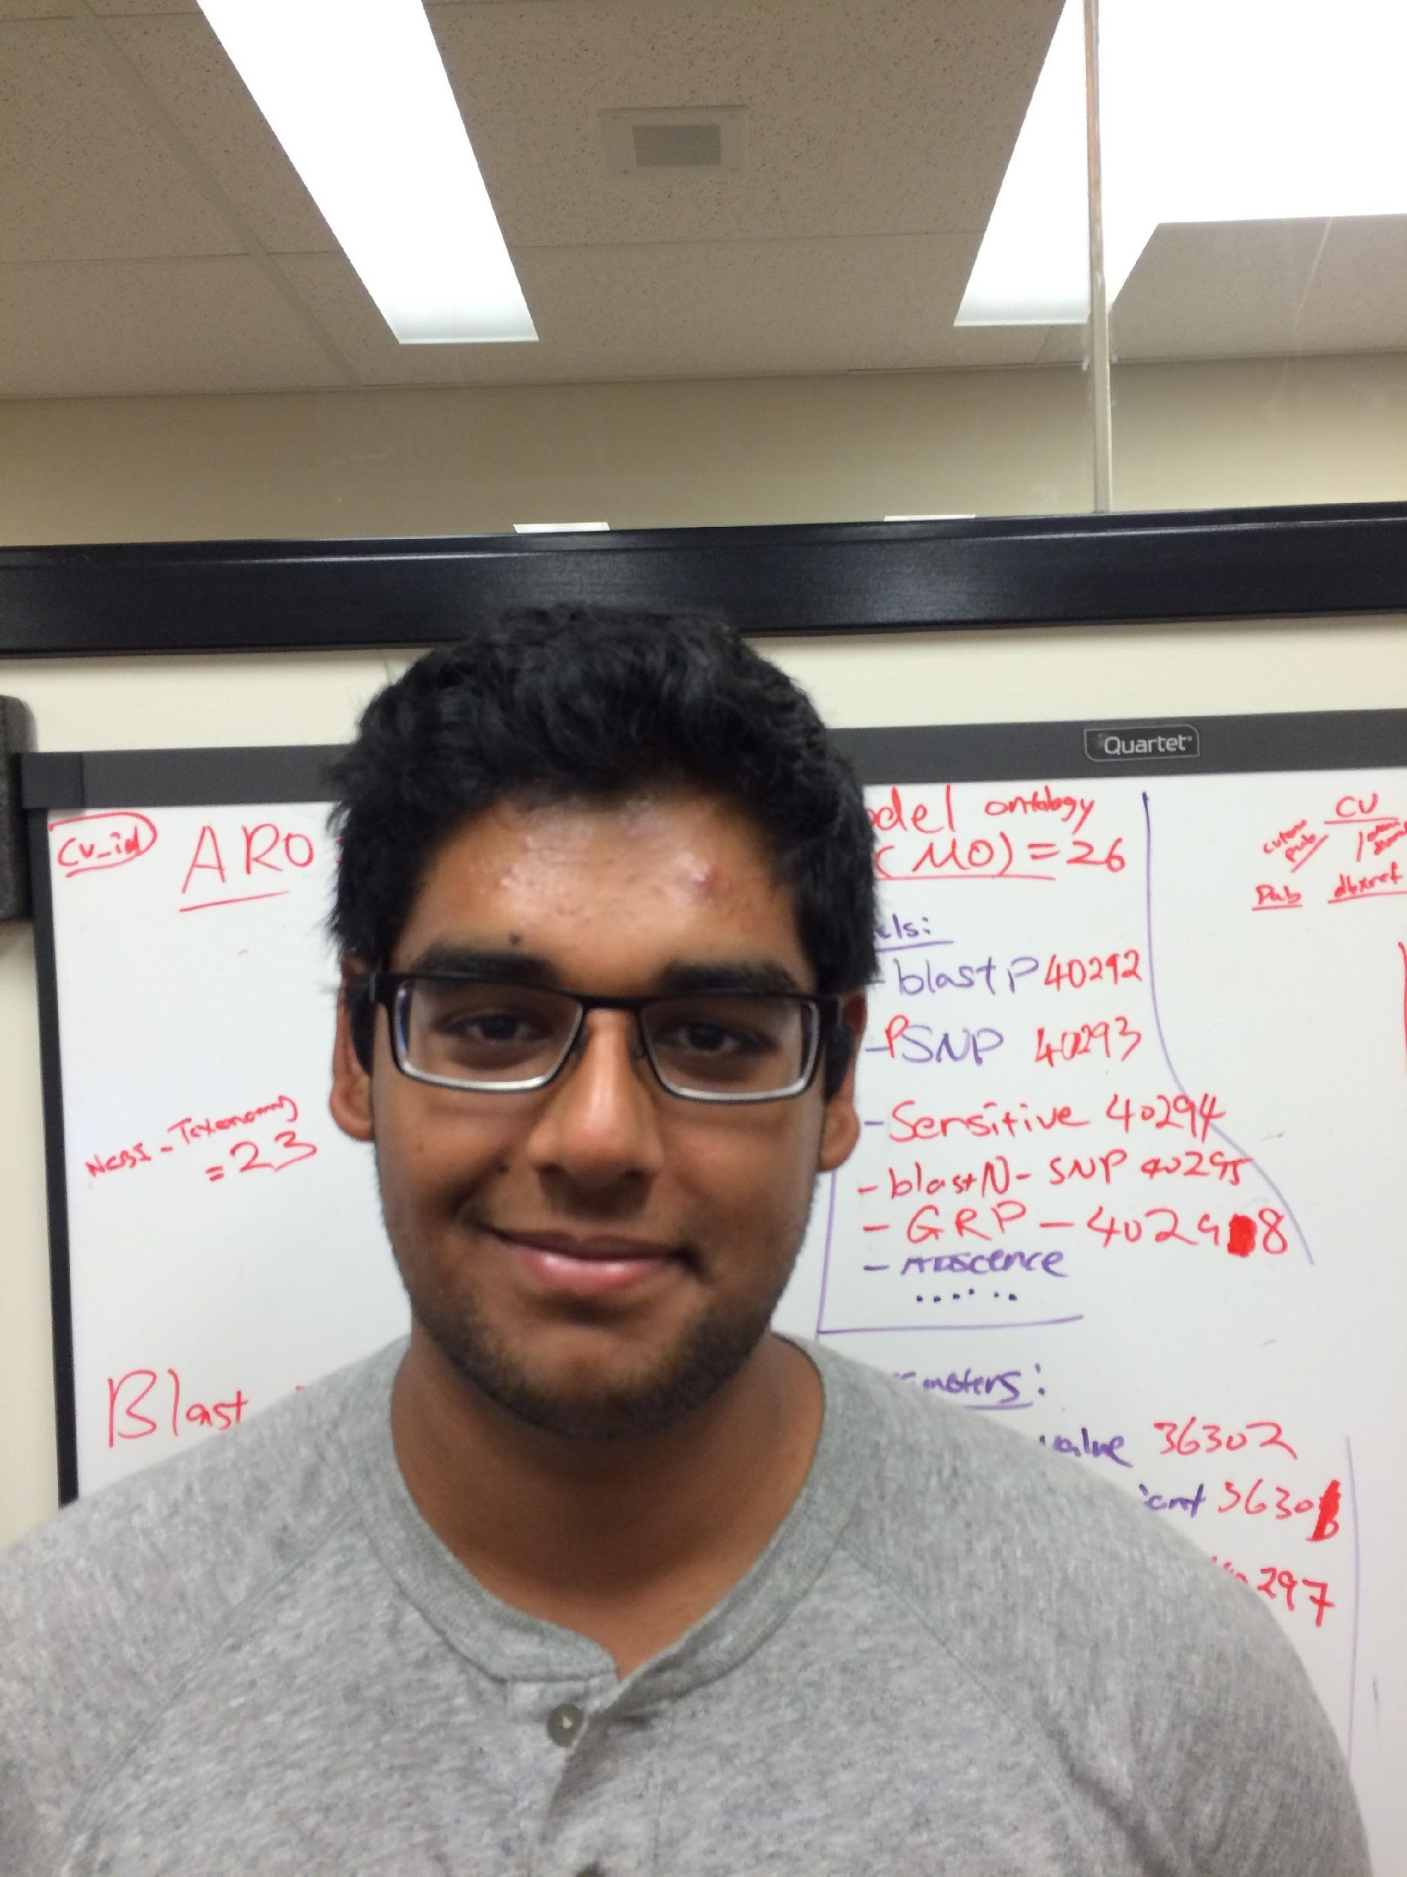
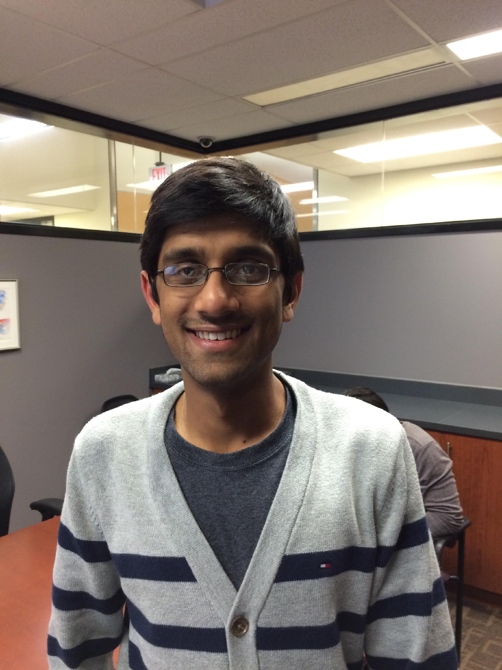
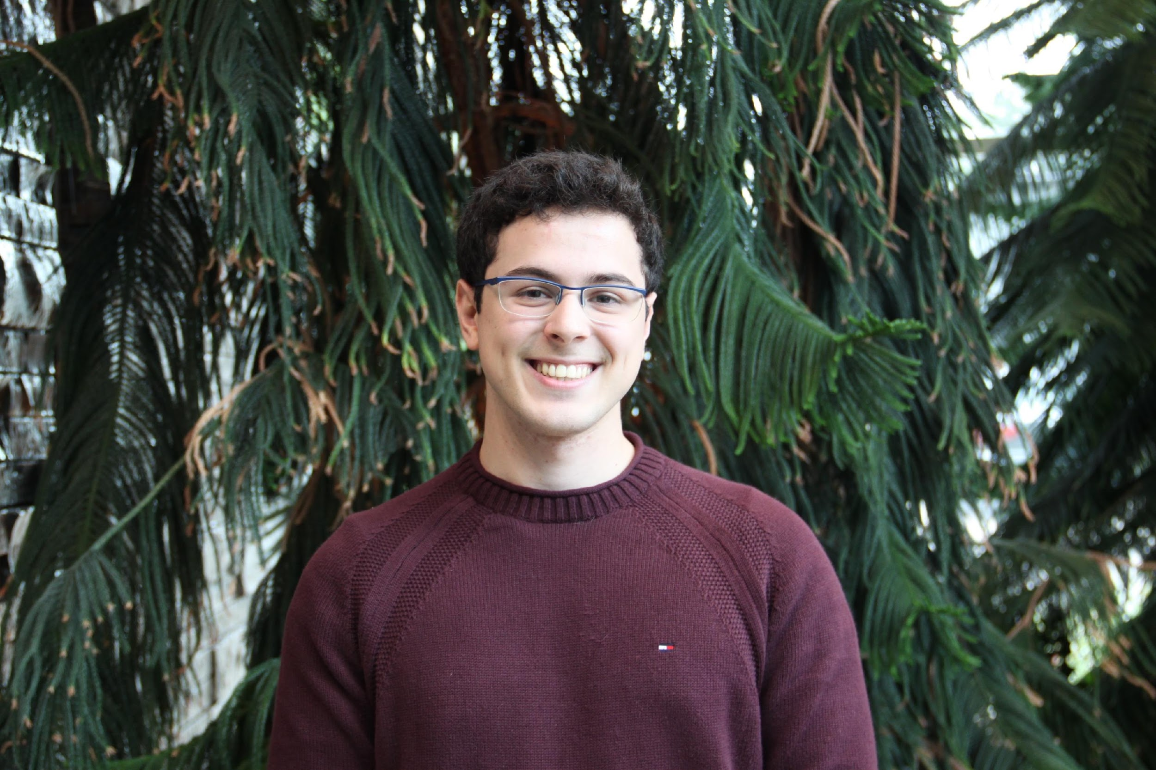
What gets into CARD?
~10000 AMR publications per year
CARD*Shark 2 & 3 text mining algorithms to prioritize and triage AMR literature
human curation
CARD
Arjun Sharma & Sachin Doshi, Biochem ‘17
AMR detection model with reference sequence, cut-offs, and parameters
Reference sequence must be published and have GenBank accession
Publication must have clear evidence of resistance
Arman Edalatmand, Biochem ’20, MSc 2022

Slide 28
Bioinformatics

Slide 29

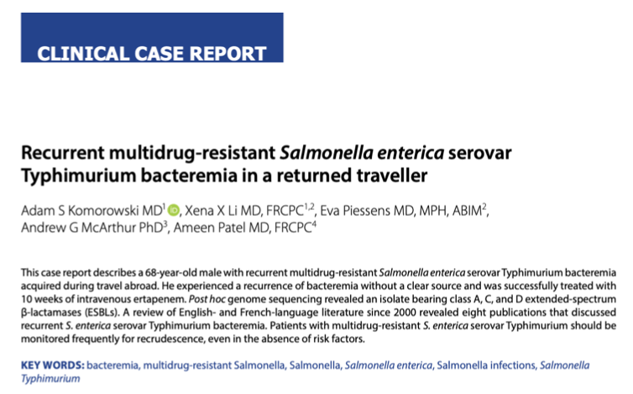
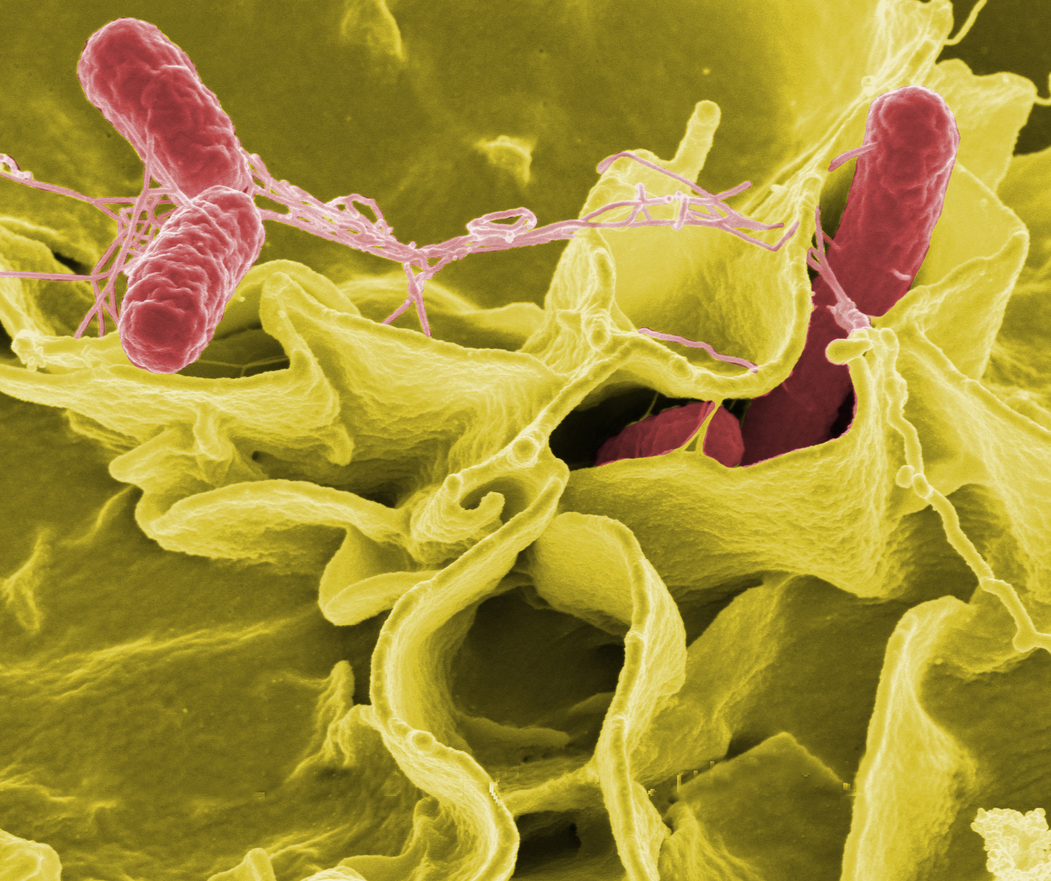
Resistance Gene Identifier
Komorowski et al. 2020. Recurrent multi-drug resistant Salmonella typhimurium bacteremia in a returned traveler: a case report. J. Assoc. Med. Microbiol. Inf. Dis. 5, 264-272

Slide 30
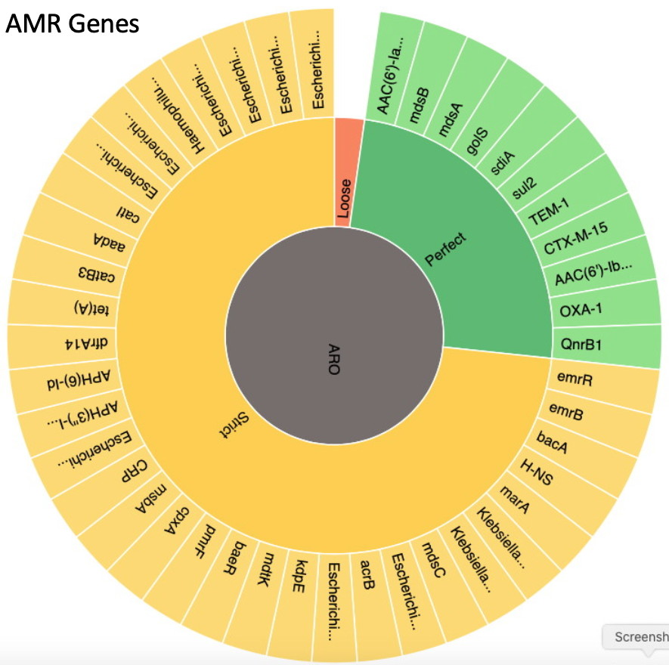
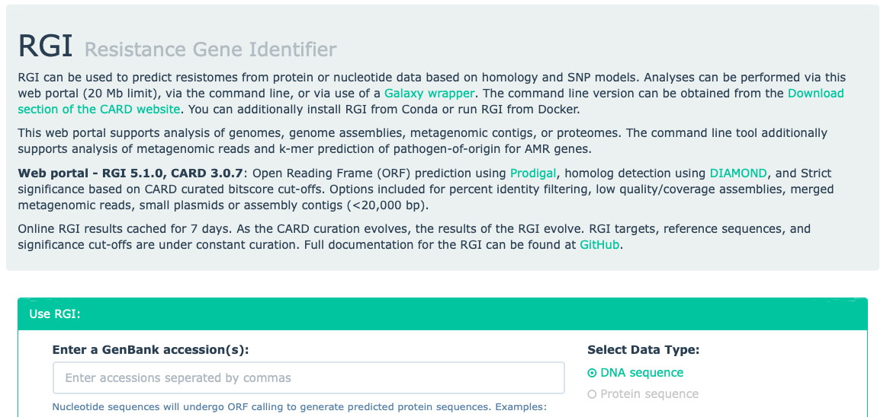
Salmonella genome sequence
CTGTCCCTTGGCTTTTTTTACTATGGTCTCGAAATGAACGTTTGTATGACTTTGCCATCC
GCTTGACGCTCTTCATAGTGATTGGCTGTGTAATCGCGGATGCTCGCACGCCAAAAGCCG
ATGGCAGGCATGTTGTTTTCCAATTGAAAGACTTCCCAGGCACCCGGGAACATTTTGAAG
ATTTGATGGGAGACCGCTTTTCCGATTCCCAGCCGACGGTAGCGTTTCATGATAAAAAAT
TCAGCAATGGAGTGGATCGATGGCAAATTTGCATCAGGGCTTGTGAGCATGCGGACGAGG
ACAAAACCAGCCAGCTTACCATTAACCTTGATGAAAAAGGGATGGCGCTCTGGTTCAACC
CAATATTTCTCAAAGTAGTCGTAGCCAAACAAGCCGTCGTCATCTACTTCGAAAGGCTCA
AACTCAGTGAAGTCGTACGTATACAGCTCCAACAGTTGCTTGAGAGCGTGCTTCTGTTCA
AAAGGAACTCGTTCTATCGAGAATGCTTGATTCACTGAGAAAACCTCCTTTTTTCTTGAG
ATATAGGAGTATCGTACTTTATTTTTTAGGTTGTGGGAACATATGGTGGACACTTCTTTA
TAGAACCTCACACGATTGATCATTTTACTTGAGGTGGTTCCAGTCGGGCTATACTAGAGT
CAAACGAAAGAAAATCAATACGAAGCAAGACAGCAGCCATACGGTGATCAGCCGGGTGGC
TGAATTGTTATTCTTATCTCAATAACAGCCTCGAGAATGTAACAACTGGGAGACGAACGA
CAAATTAATCAACGGAAACATCACATAATAGGATGGCGATGTAAAGTGAAGGTACTTGGT
CATTTCTTTTCTAAAGATGACATGGAGGAAATATCCGTATTAAAAGATCTATGTATTGGG
ATTAGTGTAAATGGTAGTCCTTTTATATGCTTTGAGGTACTAGATGATATTTTTCAGGAA
CGATATAAGCTTAGTCAACTATCAAGAGAAAAATTATTAATAATTGCAGGGCAGTTACAG
CTGTCCCTTGGCTTTTTTTACTATGGTCTCGAAATGAACGTTTGTATGACTTTGCCATCC
GCTTGACGCTCTTCATAGTGATTGGCTGTGTAATCGCGGATGCTCGCACGCCAAAAGCCG
ATGGCAGGCATGTTGTTTTCCAATTGAAAGACTTCCCAGGCACCCGGGAACATTTTGAAG
ATTTGATGGGAGACCGCTTTTCCGATTCCCAGCCGACGGTAGCGTTTCATGATAAAAAAT
TCAGCAATGGAGTGGATCGATGGCAAATTTGCATCAGGGCTTGTGAGCATGCGGACGAGG
ACAAAACCAGCCAGCTTACCATTAACCTTGATGAAAAAGGGATGGCGCTCTGGTTCAACC
CAATATTTCTCAAAGTAGTCGTAGCCAAACAAGCCGTCGTCATCTACTTCGAAAGGCTCA
AACTCAGTGAAGTCGTACGTATACAGCTCCAACAGTTGCTTGAGAGCGTGCTTCTGTTCA
AAAGGAACTCGTTCTATCGAGAATGCTTGATTCACTGAGAAAACCTCCTTTTTTCTTGAG
ATATAGGAGTATCGTACTTTATTTTTTAGGTTGTGGGAACATATGGTGGACACTTCTTTA
TAGAACCTCACACGATTGATCATTTTACTTGAGGTGGTTCCAGTCGGGCTATACTAGAGT
CAAACGAAAGAAAATCAATACGAAGCAAGACAGCAGCCATACGGTGATCAGCCGGGTGGC
TGAATTGTTATTCTTATCTCAATAACAGCCTCGAGAATGTAACAACTGGGAGACGAACGA
CAAATTAATCAACGGAAACATCACATAATAGGATGGCGATGTAAAGTGAAGGTACTTGGT
CATTTCTTTTCTAAAGATGACATGGAGGAAATATCCGTATTAAAAGATCTATGTATTGGG
ATTAGTGTAAATGGTAGTCCTTTTATATGCTTTGAGGTACTAGATGATATTTTTCAGGAA
CGATATAAGCTTAGTCAACTATCAAGAGAAAAATTATTAATAATTGCAGGGCAGTTACAG
CTGTCCCTTGGCTTTTTTTACTATGGTCTCGAAATGAACGTTTGTATGACTTTGCCATCC
GCTTGACGCTCTTCATAGTGATTGGCTGTGTAATCGCGGATGCTCGCACGCCAAAAGCCG
ATGGCAGGCATGTTGTTTTCCAATTGAAAGACTTCCCAGGCACCCGGGAACATTTTGAAG
ATTTGATGGGAGACCGCTTTTCCGATTCCCAGCCGACGGTAGCGTTTCATGATAAAAAAT
TCAGCAATGGAGTGGATCGATGGCAAATTTGCATCAGGGCTTGTGAGCATGCGGACGAGG
ACAAAACCAGCCAGCTTACCATTAACCTTGATGAAAAAGGGATGGCGCTCTGGTTCAACC
CAATATTTCTCAAAGTAGTCGTAGCCAAACAAGCCGTCGTCATCTACTTCGAAAGGCTCA
AACTCAGTGAAGTCGTACGTATACAGCTCCAACAGTTGCTTGAGAGCGTGCTTCTGTTCA
AAAGGAACTCGTTCTATCGAGAATGCTTGATTCACTGAGAAAACCTCCTTTTTTCTTGAG
ATATAGGAGTATCGTACTTTATTTTTTAGGTTGTGGGAACATATGGTGGACACTTCTTTA
TAGAACCTCACACGATTGATCATTTTACTTGAGGTGGTTCCAGTCGGGCTATACTAGAGT
CAAACGAAAGAAAATCAATACGAAGCAAGACAGCAGCCATACGGTGATCAGCCGGGTGGC
TGAATTGTTATTCTTATCTCAATAACAGCCTCGAGAATGTAACAACTGGGAGACGAACGA
CAAATTAATCAACGGAAACATCACATAATAGGATGGCGATGTAAAGTGAAGGTACTTGGT
CATTTCTTTTCTAAAGATGACATGGAGGAAATATCCGTATTAAAAGATCTATGTATTGGG
ATTAGTGTAAATGGTAGTCCTTTTATATGCTTTGAGGTACTAGATGATATTTTTCAGGAA
CGATATAAGCTTAGTCAACTATCAAGAGAAAAATTATTAATAATTGCAGGGCAGTTACAG

Slide 31
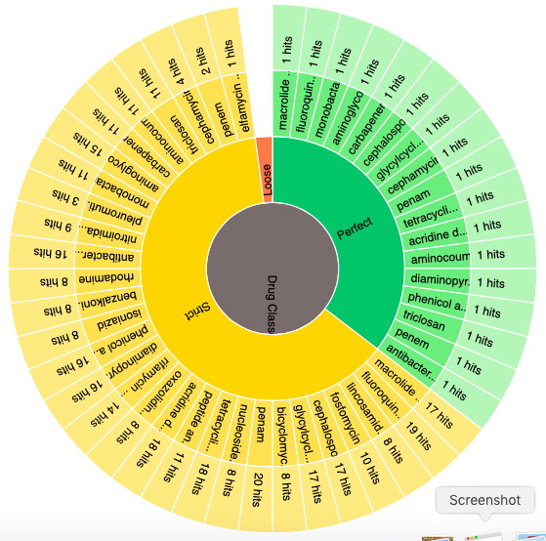
Salmonella genome sequence
CTGTCCCTTGGCTTTTTTTACTATGGTCTCGAAATGAACGTTTGTATGACTTTGCCATCC
GCTTGACGCTCTTCATAGTGATTGGCTGTGTAATCGCGGATGCTCGCACGCCAAAAGCCG
ATGGCAGGCATGTTGTTTTCCAATTGAAAGACTTCCCAGGCACCCGGGAACATTTTGAAG
ATTTGATGGGAGACCGCTTTTCCGATTCCCAGCCGACGGTAGCGTTTCATGATAAAAAAT
TCAGCAATGGAGTGGATCGATGGCAAATTTGCATCAGGGCTTGTGAGCATGCGGACGAGG
ACAAAACCAGCCAGCTTACCATTAACCTTGATGAAAAAGGGATGGCGCTCTGGTTCAACC
CAATATTTCTCAAAGTAGTCGTAGCCAAACAAGCCGTCGTCATCTACTTCGAAAGGCTCA
AACTCAGTGAAGTCGTACGTATACAGCTCCAACAGTTGCTTGAGAGCGTGCTTCTGTTCA
AAAGGAACTCGTTCTATCGAGAATGCTTGATTCACTGAGAAAACCTCCTTTTTTCTTGAG
ATATAGGAGTATCGTACTTTATTTTTTAGGTTGTGGGAACATATGGTGGACACTTCTTTA
TAGAACCTCACACGATTGATCATTTTACTTGAGGTGGTTCCAGTCGGGCTATACTAGAGT
CAAACGAAAGAAAATCAATACGAAGCAAGACAGCAGCCATACGGTGATCAGCCGGGTGGC
TGAATTGTTATTCTTATCTCAATAACAGCCTCGAGAATGTAACAACTGGGAGACGAACGA
CAAATTAATCAACGGAAACATCACATAATAGGATGGCGATGTAAAGTGAAGGTACTTGGT
CATTTCTTTTCTAAAGATGACATGGAGGAAATATCCGTATTAAAAGATCTATGTATTGGG
ATTAGTGTAAATGGTAGTCCTTTTATATGCTTTGAGGTACTAGATGATATTTTTCAGGAA
CGATATAAGCTTAGTCAACTATCAAGAGAAAAATTATTAATAATTGCAGGGCAGTTACAG
CTGTCCCTTGGCTTTTTTTACTATGGTCTCGAAATGAACGTTTGTATGACTTTGCCATCC
GCTTGACGCTCTTCATAGTGATTGGCTGTGTAATCGCGGATGCTCGCACGCCAAAAGCCG
ATGGCAGGCATGTTGTTTTCCAATTGAAAGACTTCCCAGGCACCCGGGAACATTTTGAAG
ATTTGATGGGAGACCGCTTTTCCGATTCCCAGCCGACGGTAGCGTTTCATGATAAAAAAT
TCAGCAATGGAGTGGATCGATGGCAAATTTGCATCAGGGCTTGTGAGCATGCGGACGAGG
ACAAAACCAGCCAGCTTACCATTAACCTTGATGAAAAAGGGATGGCGCTCTGGTTCAACC
CAATATTTCTCAAAGTAGTCGTAGCCAAACAAGCCGTCGTCATCTACTTCGAAAGGCTCA
AACTCAGTGAAGTCGTACGTATACAGCTCCAACAGTTGCTTGAGAGCGTGCTTCTGTTCA
AAAGGAACTCGTTCTATCGAGAATGCTTGATTCACTGAGAAAACCTCCTTTTTTCTTGAG
ATATAGGAGTATCGTACTTTATTTTTTAGGTTGTGGGAACATATGGTGGACACTTCTTTA
TAGAACCTCACACGATTGATCATTTTACTTGAGGTGGTTCCAGTCGGGCTATACTAGAGT
CAAACGAAAGAAAATCAATACGAAGCAAGACAGCAGCCATACGGTGATCAGCCGGGTGGC
TGAATTGTTATTCTTATCTCAATAACAGCCTCGAGAATGTAACAACTGGGAGACGAACGA
CAAATTAATCAACGGAAACATCACATAATAGGATGGCGATGTAAAGTGAAGGTACTTGGT
CATTTCTTTTCTAAAGATGACATGGAGGAAATATCCGTATTAAAAGATCTATGTATTGGG
ATTAGTGTAAATGGTAGTCCTTTTATATGCTTTGAGGTACTAGATGATATTTTTCAGGAA
CGATATAAGCTTAGTCAACTATCAAGAGAAAAATTATTAATAATTGCAGGGCAGTTACAG
CTGTCCCTTGGCTTTTTTTACTATGGTCTCGAAATGAACGTTTGTATGACTTTGCCATCC
GCTTGACGCTCTTCATAGTGATTGGCTGTGTAATCGCGGATGCTCGCACGCCAAAAGCCG
ATGGCAGGCATGTTGTTTTCCAATTGAAAGACTTCCCAGGCACCCGGGAACATTTTGAAG
ATTTGATGGGAGACCGCTTTTCCGATTCCCAGCCGACGGTAGCGTTTCATGATAAAAAAT
TCAGCAATGGAGTGGATCGATGGCAAATTTGCATCAGGGCTTGTGAGCATGCGGACGAGG
ACAAAACCAGCCAGCTTACCATTAACCTTGATGAAAAAGGGATGGCGCTCTGGTTCAACC
CAATATTTCTCAAAGTAGTCGTAGCCAAACAAGCCGTCGTCATCTACTTCGAAAGGCTCA
AACTCAGTGAAGTCGTACGTATACAGCTCCAACAGTTGCTTGAGAGCGTGCTTCTGTTCA
AAAGGAACTCGTTCTATCGAGAATGCTTGATTCACTGAGAAAACCTCCTTTTTTCTTGAG
ATATAGGAGTATCGTACTTTATTTTTTAGGTTGTGGGAACATATGGTGGACACTTCTTTA
TAGAACCTCACACGATTGATCATTTTACTTGAGGTGGTTCCAGTCGGGCTATACTAGAGT
CAAACGAAAGAAAATCAATACGAAGCAAGACAGCAGCCATACGGTGATCAGCCGGGTGGC
TGAATTGTTATTCTTATCTCAATAACAGCCTCGAGAATGTAACAACTGGGAGACGAACGA
CAAATTAATCAACGGAAACATCACATAATAGGATGGCGATGTAAAGTGAAGGTACTTGGT
CATTTCTTTTCTAAAGATGACATGGAGGAAATATCCGTATTAAAAGATCTATGTATTGGG
ATTAGTGTAAATGGTAGTCCTTTTATATGCTTTGAGGTACTAGATGATATTTTTCAGGAA
CGATATAAGCTTAGTCAACTATCAAGAGAAAAATTATTAATAATTGCAGGGCAGTTACAG
Drug Classes

Slide 32

Resistance Gene Identifier
perfect
matches reference
sequence
“known known”
strict
similarity within
model
“known unknown”
loose / discovery
“unknown unknown”
similarity outside
of model

Slide 33
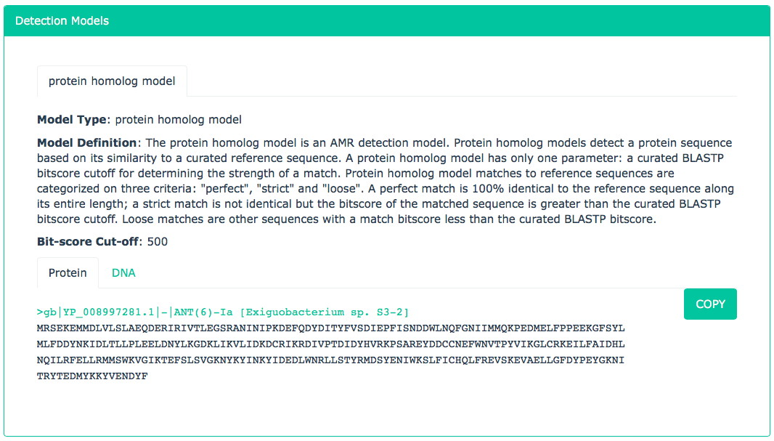
Bioinformatic Models

Slide 34


Bioinformatic Models

Slide 35

Bioinformatic Models
protein homolog model
e.g. extended spectrum beta-lactamase
*
protein variant model
e.g. fluoroquinolone resistant gyrB
rRNA gene variant model
*
e.g. hygromycin B resistant 23S rRNA
protein overexpression model
*
e.g. upregulated MDR in Pseudomonas
protein knockout model
e.g. imipenem resistance in A. baumannii
nonfunctional insertion model
gene cluster meta-model
e.g. vancomycin resistance
efflux pump system meta-model
Karyn Mukiri, PhD Student

Slide 36

Culture-free Metagenomics – Resistance Gene Identifier – bwt branch
AMR genes are the needle in the haystack
It takes a lot of (expensive) DNA sequencing
The data is very fragmentary
Analysis sensitive to the diversity of reference data
Even if we find an AMR gene, which bacteria did it come from?
host
microbiome
AMR

Slide 37


Culture-free Metagenomics – Pathogen-of-Origin k-mers
Wlodarski et al. 2025. CARD k-mers: Unmasking the pathogen hosts and genomic contexts of antimicrobial resistance genes in metagenomic sequences. bioRxiv 2025.09.15.676352.

Slide 38
Analytics & Interpretation

Slide 39
AMR is a ‘One Health’ & ‘Wicked’ Problem
Ethanol
Fuel
AQUACULTURE
ETHANOL FUEL PRODUCERS
Sea / Lakes
Swimming
Drinking
Water
Distillers Grain
By-Products
Drinking
Water
Rivers and Streams
Industrial &
Household
ANTIBACTERIAL
CHEMICALS
Land Fill
Soil
Farm Effluents and Manure Spreading
Sewage
Dead Stock
Wildlife
Rendering
Offal
VEGETATION
SEED CROPS
FRUIT
FOOD
ANIMALS
HUMAN
POULTRY
HOSPITALIZED
COMMUNITY
URBAN AND
RURAL
Animal
Feeds
SHEEP
CATTLE
Commercial
Abattoirs /
Processing
Plants
Handling
Preparation
Consumption
VEAL
CALVES
POULTRY
Meat
EXTENDED
CARE
FACILITIES
TRAVELLERS
OHER
FARMED
LIVESTOCK
COMPANION
ANIMALS
Direct
Contact
Imports

Slide 40




https://www.gov.uk/government/publications/antimicrobial-resistance-amr-systems-map

Slide 41

Predicting Risk

Slide 42

Predicting Risk

Slide 43


Rules-based algorithm leads to poor phenotype prediction
Number of E. coli isolates (n=115)
Kara Tsang, PhD 2021
Tsang et al. 2021. Identifying novel β-lactamase substrate activity through in silico prediction of antimicrobial resistance. Microbial Genomics 7:mgen000500.

Slide 44

Machine learning algorithm leads to improved phenotype prediction accuracy
Number of E. coli isolates (n=115)
Kara Tsang, PhD 2021
Tsang et al. 2021. Identifying novel β-lactamase substrate activity through in silico prediction of antimicrobial resistance. Microbial Genomics 7:mgen000500.

Slide 45




Weights of predictive importance identify novel substrate activity
Each resistance determinant is assigned a weight (↑ weight = ↑ importance for phenotype prediction)
CTX-M-15
ceftazidime
ceftriaxone
cefalotin
cefazolin
Haley Zubyk, Wright Lab
Sommer Chou, Wright Lab
Dr. Kara Tsang
Cox, G., et al. 2017. A common platform for antibiotic dereplication and adjuvant discovery. Cell Chem Biol 24:98-109.

Slide 46




~204,000 AMR papers in PubMed
~10,000 added AMR papers per year
Arman Edalatmand
MSc 2022
~10k papers from 2019
Lee et al. 2019. BioBERT: a pre-trained biomedical language representation model for biomedical text mining. arXiv:1901.08746.

Slide 47


~204,000 AMR papers in PubMed
~10,000 added AMR papers per year
Tiffany Ta, MSc Student
Lee et al. 2019. BioBERT: a pre-trained biomedical language representation model for biomedical text mining. arXiv:1901.08746.

Slide 48



The Future
Rapid Response Strategies
Early Detection of Emergent Threats
Inform Public Policy
Guide Clinical Practice
Enable Targeted Drug Development
artificial intelligence
machine learning
Aspergillomarasmine A vs. NDM-1
King et al. Nature 2014 510:503-506
adjuvants!
lipid targets!
Teixobactin vs. lipids
Ling et al. Nature 2015 517:455-459

Slide 49

Questions?
Dr. Gerry Wright, IIDR, and the CARD Consortium
GenEpiO Consortium
National Microbiology Laboratory, Canada – IRIDA Surveillance Project
National Center for Biotechnology Information (NCBI, USA)
bioMérieux France, Inc.
IslandViewer Database – Dr. Fiona Brinkman, UBC
McMaster Industrial Liaison Office

Slide 50
Comprehensive Antibiotic Resistance Database
5+ million page views
Over 350,000 users
77.9% new, 22.1% returning visitors
CARD website analyzes a MDR genome every 4 minutes
In use by >150 Public Health Agencies
Licensed to 50 companies in a variety of sectors
Last 7 days – Public Health Agencies
Citations
McArthur et al. 2013 2376
Jia et al. 2017 2729
Alcock et al. 2020 3589
Alcock et al. 2023 2023
Total 10469
Adoption
NCBI -> EPA, USDA, FDA, DHS, DoD
Databases -> IslandViewer, GenBank, NDARO
Models -> ResFams, Meta-MARC
Tools -> AMR⁺⁺, SEARS, etc.

Slide 51



COMMERCIALIZATION PHILOSOPHY
Entirely Free to Academics
Entirely Free to Governments or Public Health Agencies*
Industrial Use Requires a License

Slide 52

Intellectual Property Protection
CARD Website
copyright
trademarks
CARD logo
Antibiotic Resistance Ontology knowledgebase
copyright
CC-BY license version 4.0
Antibiotic Resistance Reference Sequence & Mutation Collection
copyright
Resistome Gene Identifier Software
copyright
Resistomes, Variants, & Prevalence Collection
copyright
AMR Bait Capture Platform
copyright, ‘process’ patent
CC-BY license version 4.0
CARD Services
NDA/CDA & Contract

Slide 53
Licensing Strategy

Slide 54


Licensing Strategy

Slide 55



Lead Generation
Copyright and Disclaimer
card@mcmaster.ca
Marketing
Publications
Scientific Conferences
B2B
Workshops
YouTube
MILO campaigns
Aggressive IP scanning for license violators

Slide 56
Sabbatical:
“A paid leave, usually for 6-12 months, for academics and researchers to step away from regular teaching and service duties to focus intensely on research, learn new techniques, develop new ideas, or collaborate at other institutions for professional growth, intellectual refreshment, and career advancement.”

Slide 57


Sabbatical:
“A paid leave, usually for 6-12 months, for academics and researchers to step away from regular teaching and service duties to focus intensely on research, learn new techniques, develop new ideas, or collaborate at other institutions for professional growth, intellectual refreshment, and career advancement.”
AMR Surveillance
Biocuration

Slide 58
Sabbatical:
“A paid leave, usually for 6-12 months, for academics and researchers to step away from regular teaching and service duties to focus intensely on research, learn new techniques, develop new ideas, or collaborate at other institutions for professional growth, intellectual refreshment, and career advancement.”
AMR Surveillance
Biocuration

Slide 59
Sabbatical:
“A paid leave, usually for 6-12 months, for academics and researchers to step away from regular teaching and service duties to focus intensely on research, learn new techniques, develop new ideas, or collaborate at other institutions for professional growth, intellectual refreshment, and career advancement.”
AMR Surveillance
Biocuration
“I chose CARD over other AMR databases due to its commitment to quality manual curation”
- One Health AMR & Emerging Zoonoses Conference 2025

Slide 60



AI & Large Language Models
Natural Language Processing
Versus
Generative AI

Slide 61

Task #1 : Data Identification
41486627
41502406
41410397
41363859
41478678
41442899
41442898
41418580
41406564
41397327
41508433
41453699
41452091
41412666
41360524
41460919
41460792
41433414
41417869
41416726
41405436
41405126
41399182
41369274
41368878
41367276
41363037
41504568
41504567
41504565
41504564
41504563
41504562
41499589
41453202
41461032
41495909
41490132
41489657
41364775
41481724
41481700
41481559
41481359
41363705
41511472
41505159
41495621
41482834
41467599
41460137
41457978
41457938
41448022
41432360
41420059
41418358
41411925
41407001
41389591
41395768
41362921
41469410
41468439
41462121
41456891
41433063
41460948
41460537
41460334
41460274
41455885
41455716
41454966
41454505
41454504
41454501
41381039
41447408
41444938
41503038
41432965
41430117
41472585
41472582
41430708
41430092
41428077
41416731
41479748
41422186
41488616
41488482
41420092
41419543
41417296
41465192
41431648
41424810
41413428
41413277
41413196
41413138
41410726
41479546
41471252
41405784
41405765
41405675
41405660
41405200
41402124
41401143
41504093
41471244
41465500
41396311
41396199
41397756
41465445
41390780
41390665
41390371
41387691
41386779
41385521
41385133
41471229
41459162
41459145
41458536
41379860
41379350
41379167
41471222
41471219
41465335
41450571
41372311
41372160
41370031
41446279
41366200
41365577
41364252
41364194
41471209
41471208
41439254
41365553
41361579
41360615
41429553
41429546
41465211
41465128
41426698
41470153
41409546
41373828
41503625
41490992
41490734
41490657
41450110
41436327
41431768
41431405
41429668
41429182
41420313
41416578
41411654
41410219
41407557
41406009
41402092
41399971
41396803
41392382
41385864
41385265
41384791
41384376
41381995
41369527
41367228
41366877
41364585
41363878
41360592
41360574
41471173
41471170
41406172
41395869
41394107
41394105
41470116
41373671
41383853
41376792
41376789
41471155
41464412
41368435
41368433
41471146
41373424
41443718
41437595
41418113
41399818
41384662
41379698
41379610
41411386
41411385
41411383
41391020
41378405
41378637
41396039
41369271
41443839
41416598
41392558
Craft & validate prompts:
Which describe an antibiotic resistance gene?
Which describe an antibiotic resistance gene not in CARD?
Which describe a gene:drug relationship?
Which describe the association of an antibiotic resistance gene with a mobile genetic element?
pmid-antibiotic-set-2.txt
PMID from PubMED
AMR filtered
Last 72 hours
227 total

Slide 62
Task #2 : Description Generation
Write a three sentence summary of the usage, drug class, history, and known resistance of the antibiotics provided. Write the summaries in plain English and do not include citations. Do not use information from the Comprehensive Antibiotic Resistance Database.
antibiotic_summaries.tsv
Based on PubMed, write a three sentence summary of the epidemiology, history, and specific antibiotics impacted for the resistance genes provided. If no information is found for a resistance gene, skip it and use a different random resistance gene. Write the summaries in plain English and do not include citations. Do not use information from the Comprehensive Antibiotic Resistance Database.
args_summaries.tsv
Based on PubMed, write a three sentence summary of the plasmids, transposable elements, food-bourne pathogens, and Canadian epidemiology for the resistance genes provided. If no information is found for a resistance gene, skip it and use a different random resistance gene. Write the summaries in plain English and do not include citations. Do not use information from the Comprehensive Antibiotic Resistance Database.
args_epi_summaries.tsv

Slide 63
Task #3 : 2-3 minute presentation by each team
How did ChatGPT do with antibiotic molecule and resistance gene information?
Pros, cons, and suggestions for use of Generative AI without breaking CARD’s trust-based market
How would you market CARD GenAI data?
https://github.com/agmcarthur/BIOMEDDC-3A03

